Slide 1


Slide 2

2025
Honors & Awards Ceremony

Slide 3

THANK YOU
TO OUR SPONSOR

Slide 4

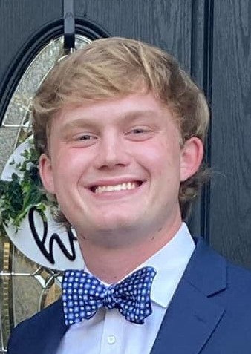

Hannah Sobeski Memorial Scholarship
George “Samuel” Wham, III
River Bluff High School
Will be attending the Citadel
Son of Dr. George & Julie Hartley Wham

Slide 5
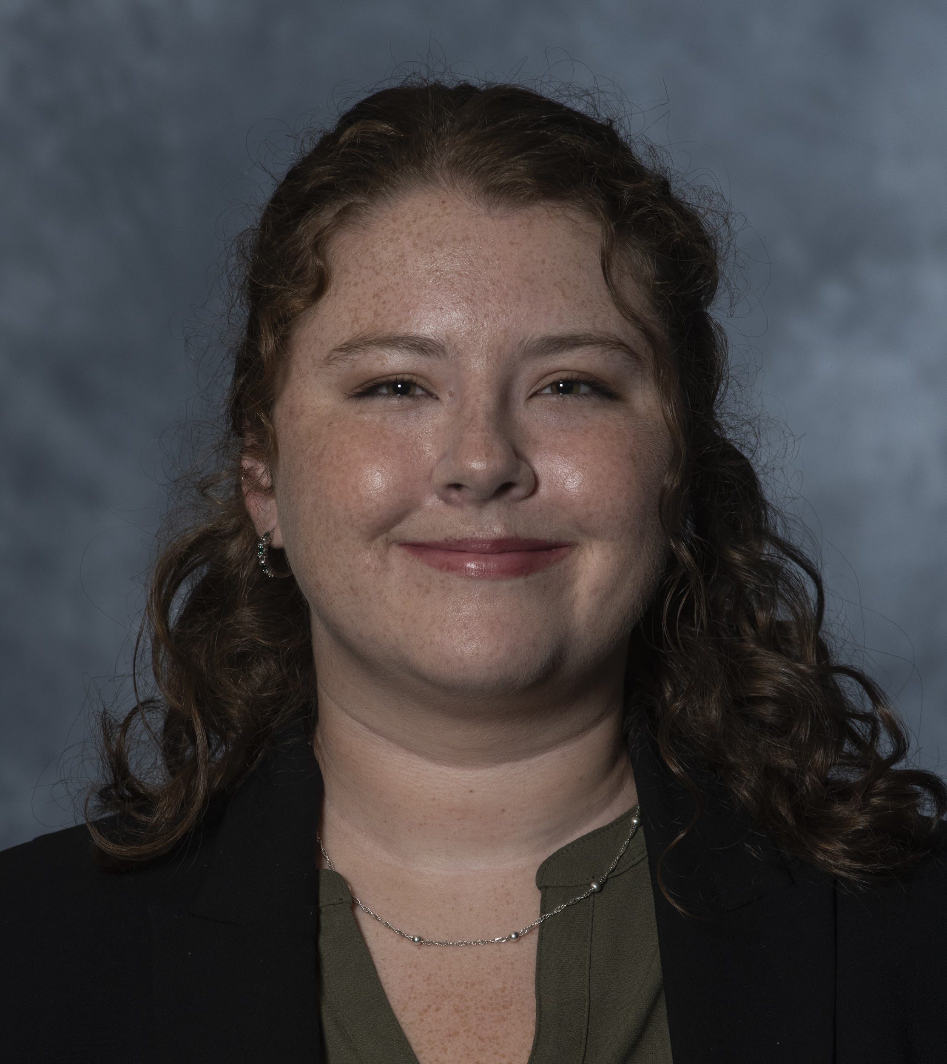
Terry Lewis
Professional Scholarship
Hannah Arnett, MS, ATC
MAT Graduate
University of South Carolina

Slide 6
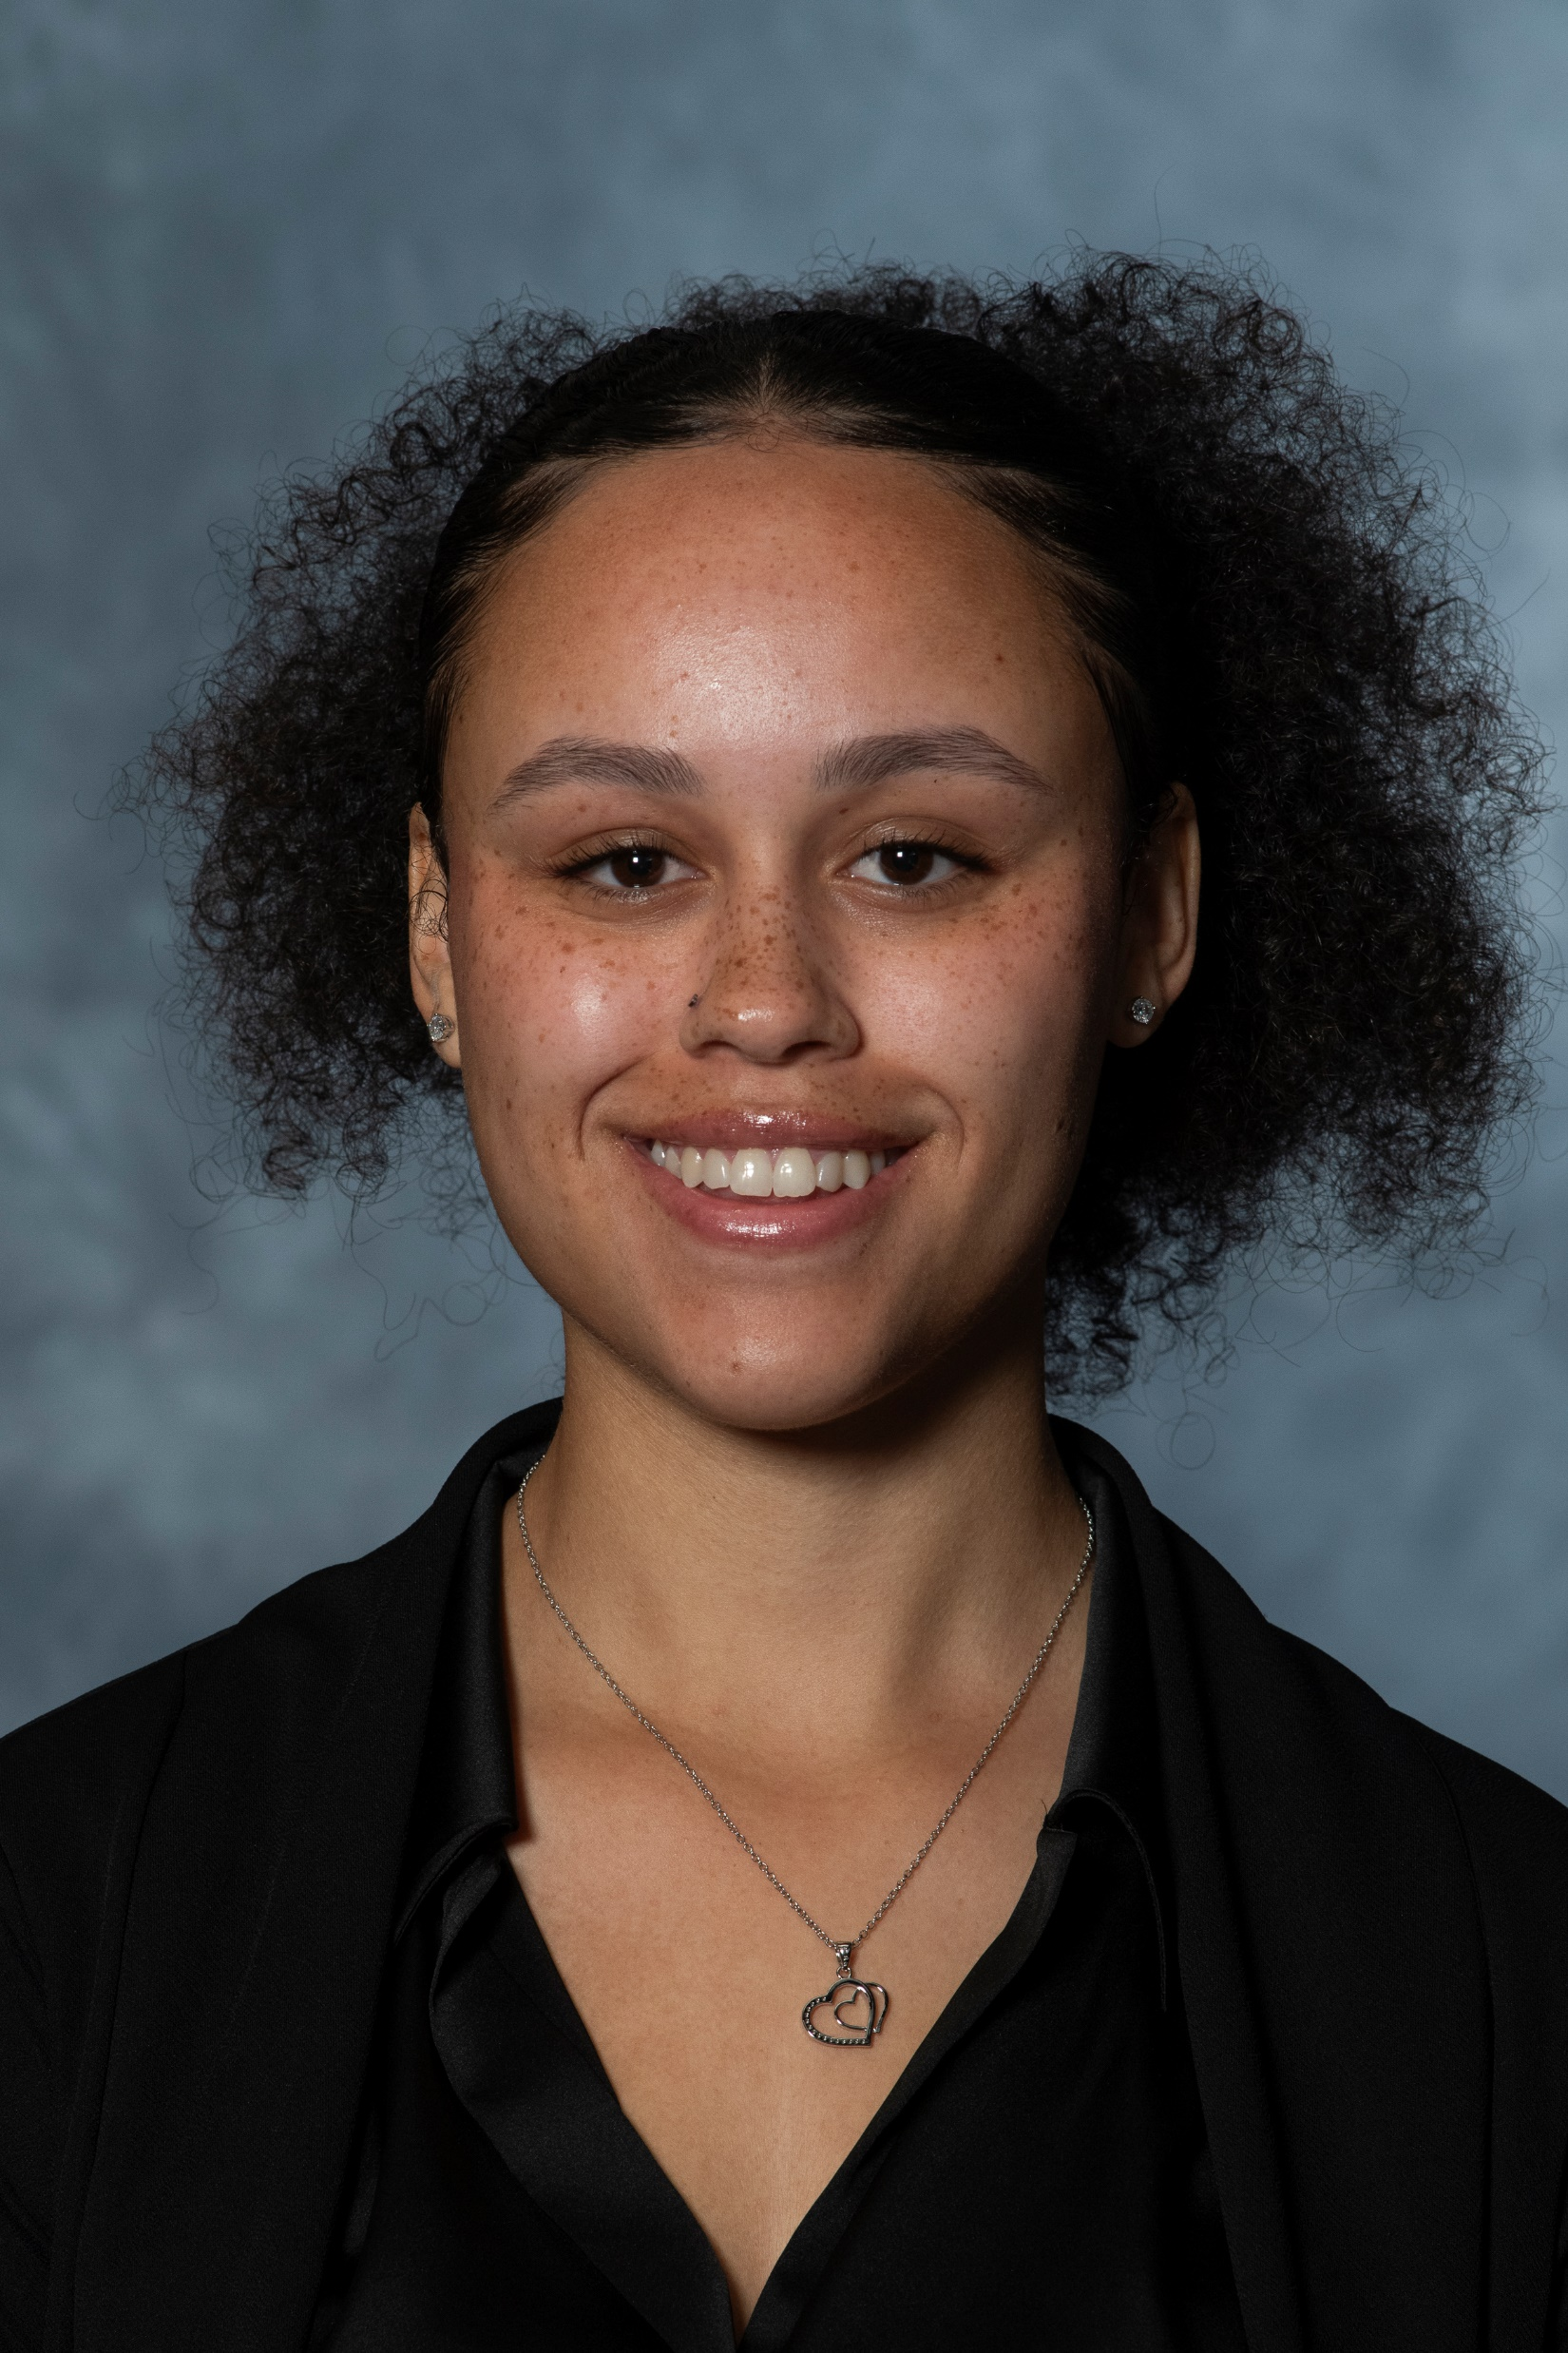
Terry Lewis
Post-Professional Scholarship
Rachel Dipeolu, LAT, ATC
Post-Professional Athletic Training Graduate
University of South Carolina

Slide 7

Free Communications
Poster Presentation Award
Evan Sanderson
University of South Carolina

Slide 8

Free Communications
Poster Presentation Award
Kendall Doyle
University of South Carolina

Slide 9
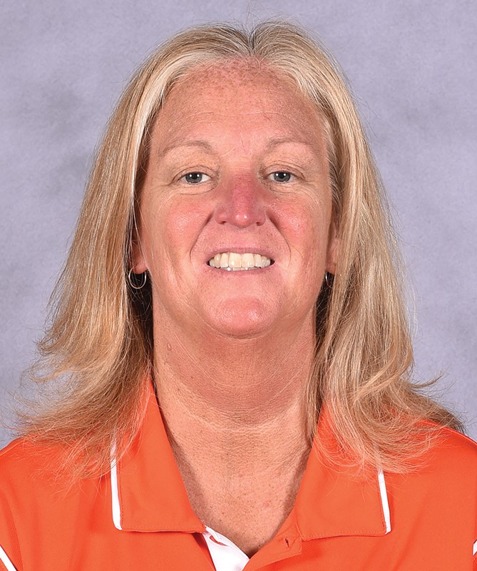
SCATA Athletic Training
Service Award
Donna Bullock, LAT, ATC
Assistant Athletic Trainer
Clemson University
Clemson, SC

Slide 10
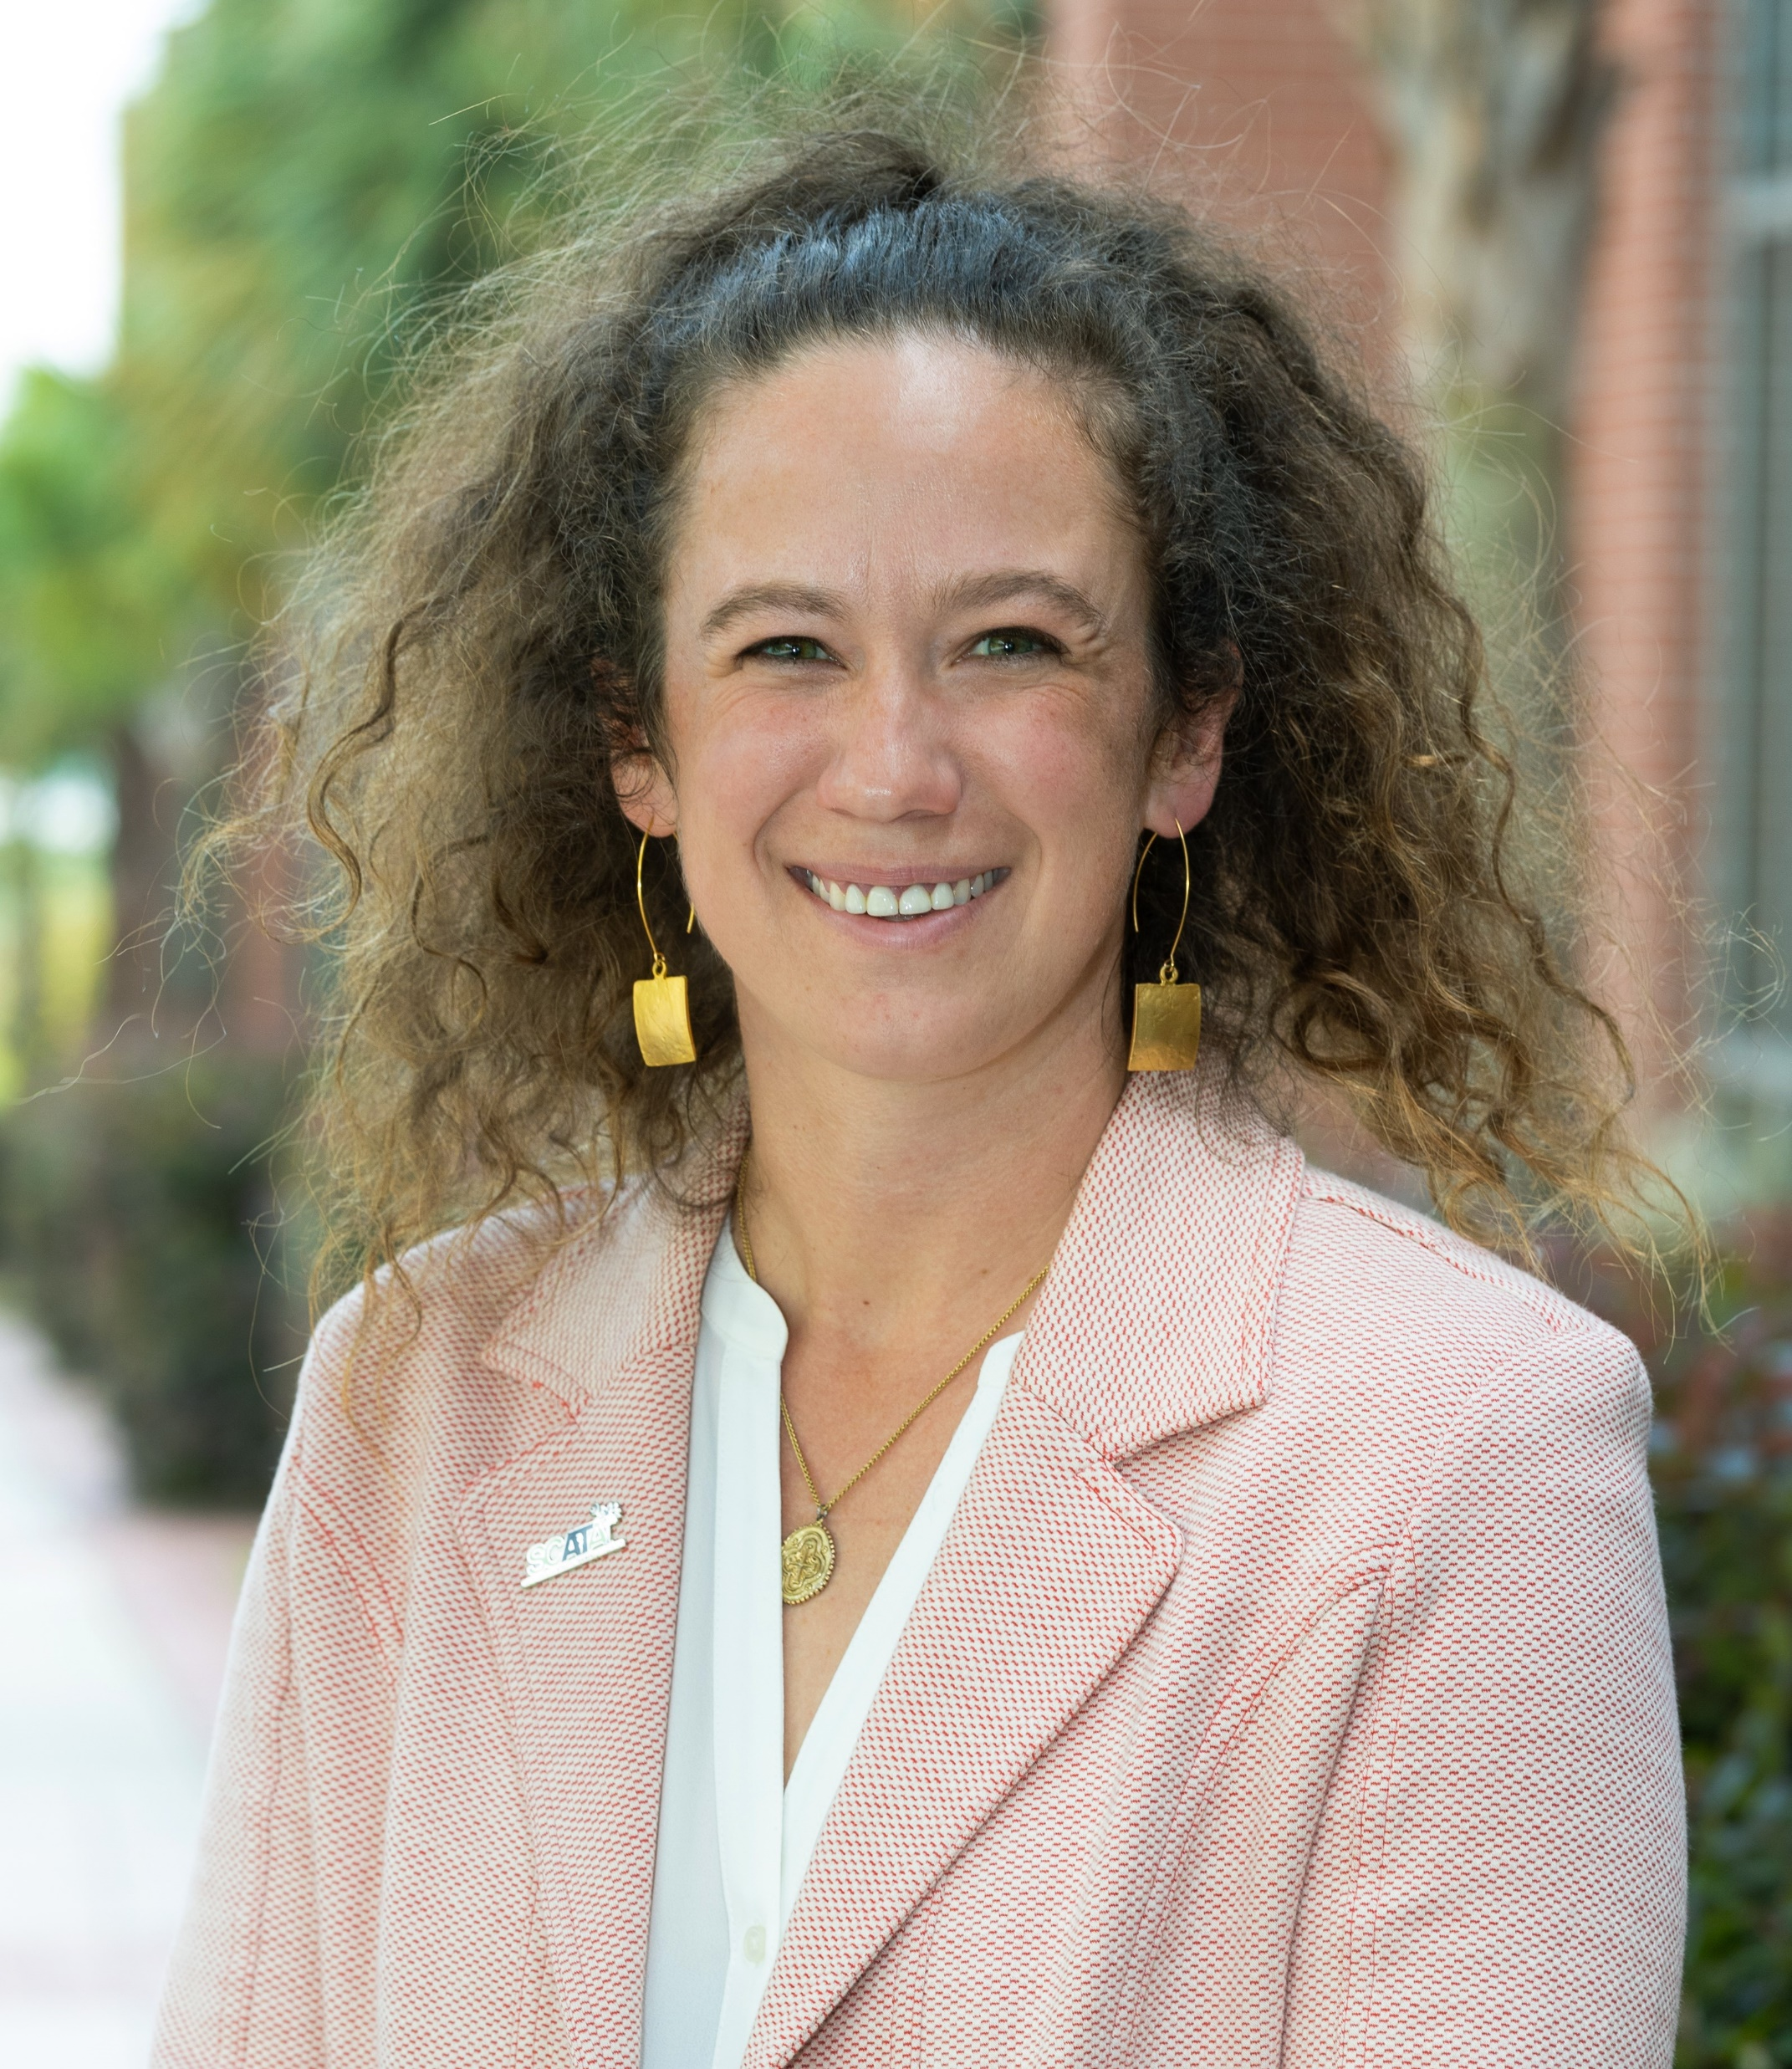
SCATA Athletic Training
Service Award
Amy L. Fraley, PhD, LAT, ATC
Clinical Assistant Professor
Athletic Training
University of South Carolina
Columbia, SC

Slide 11
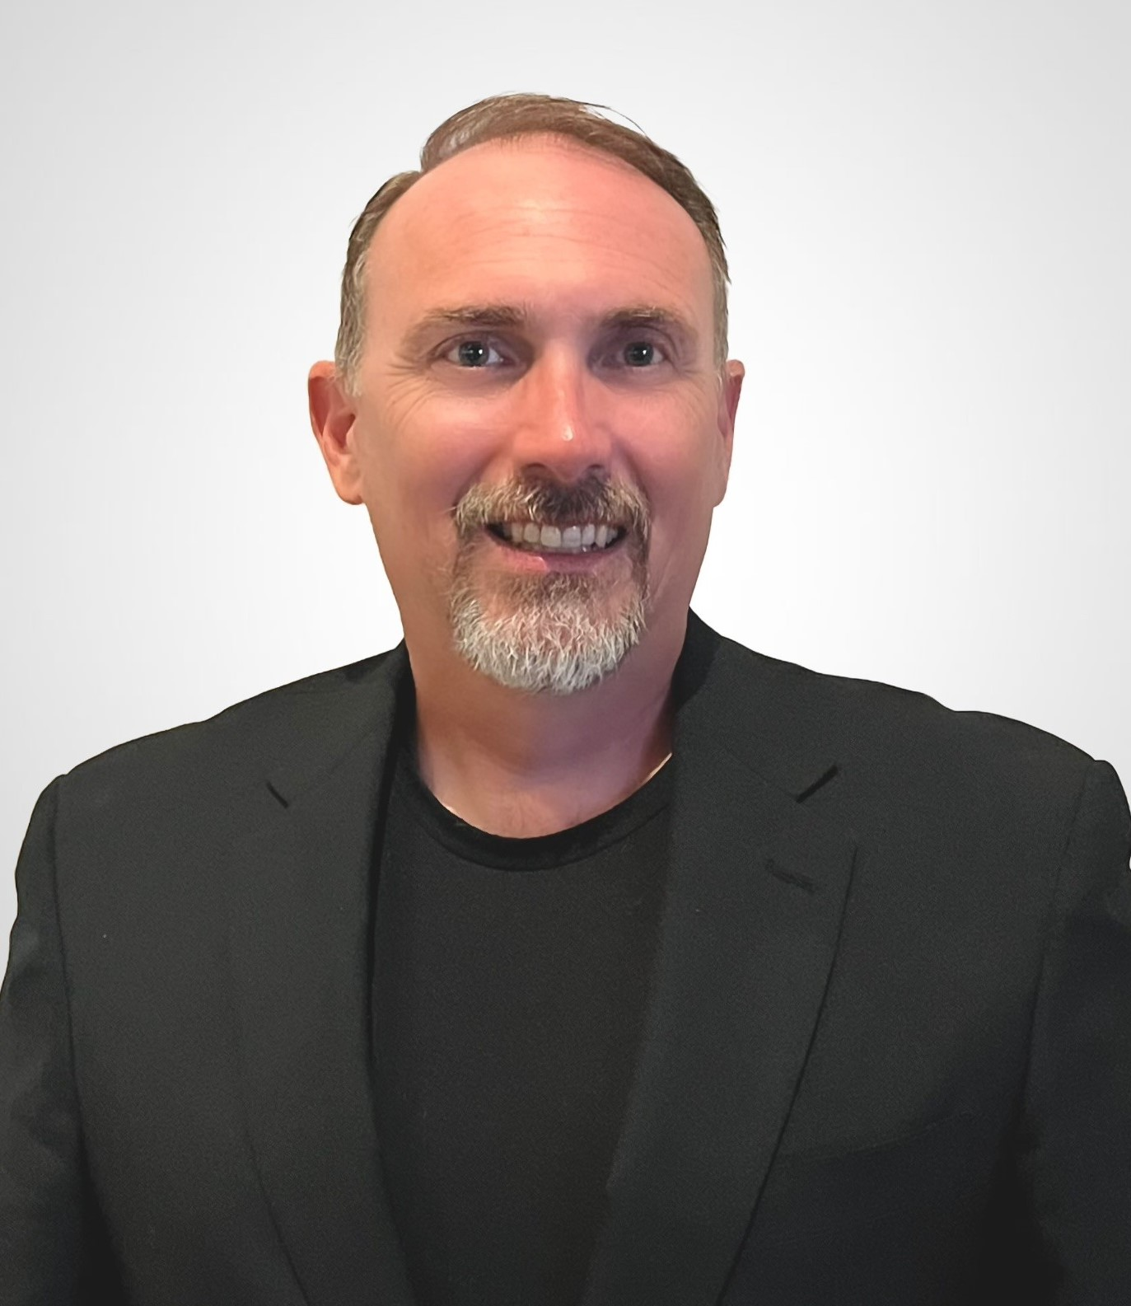
SCATA Athletic Training
Service Award
Jason Keesee, LAT, ATC
Head Athletic Trainer
Socastee High School
Myrtle Beach, SC

Slide 12
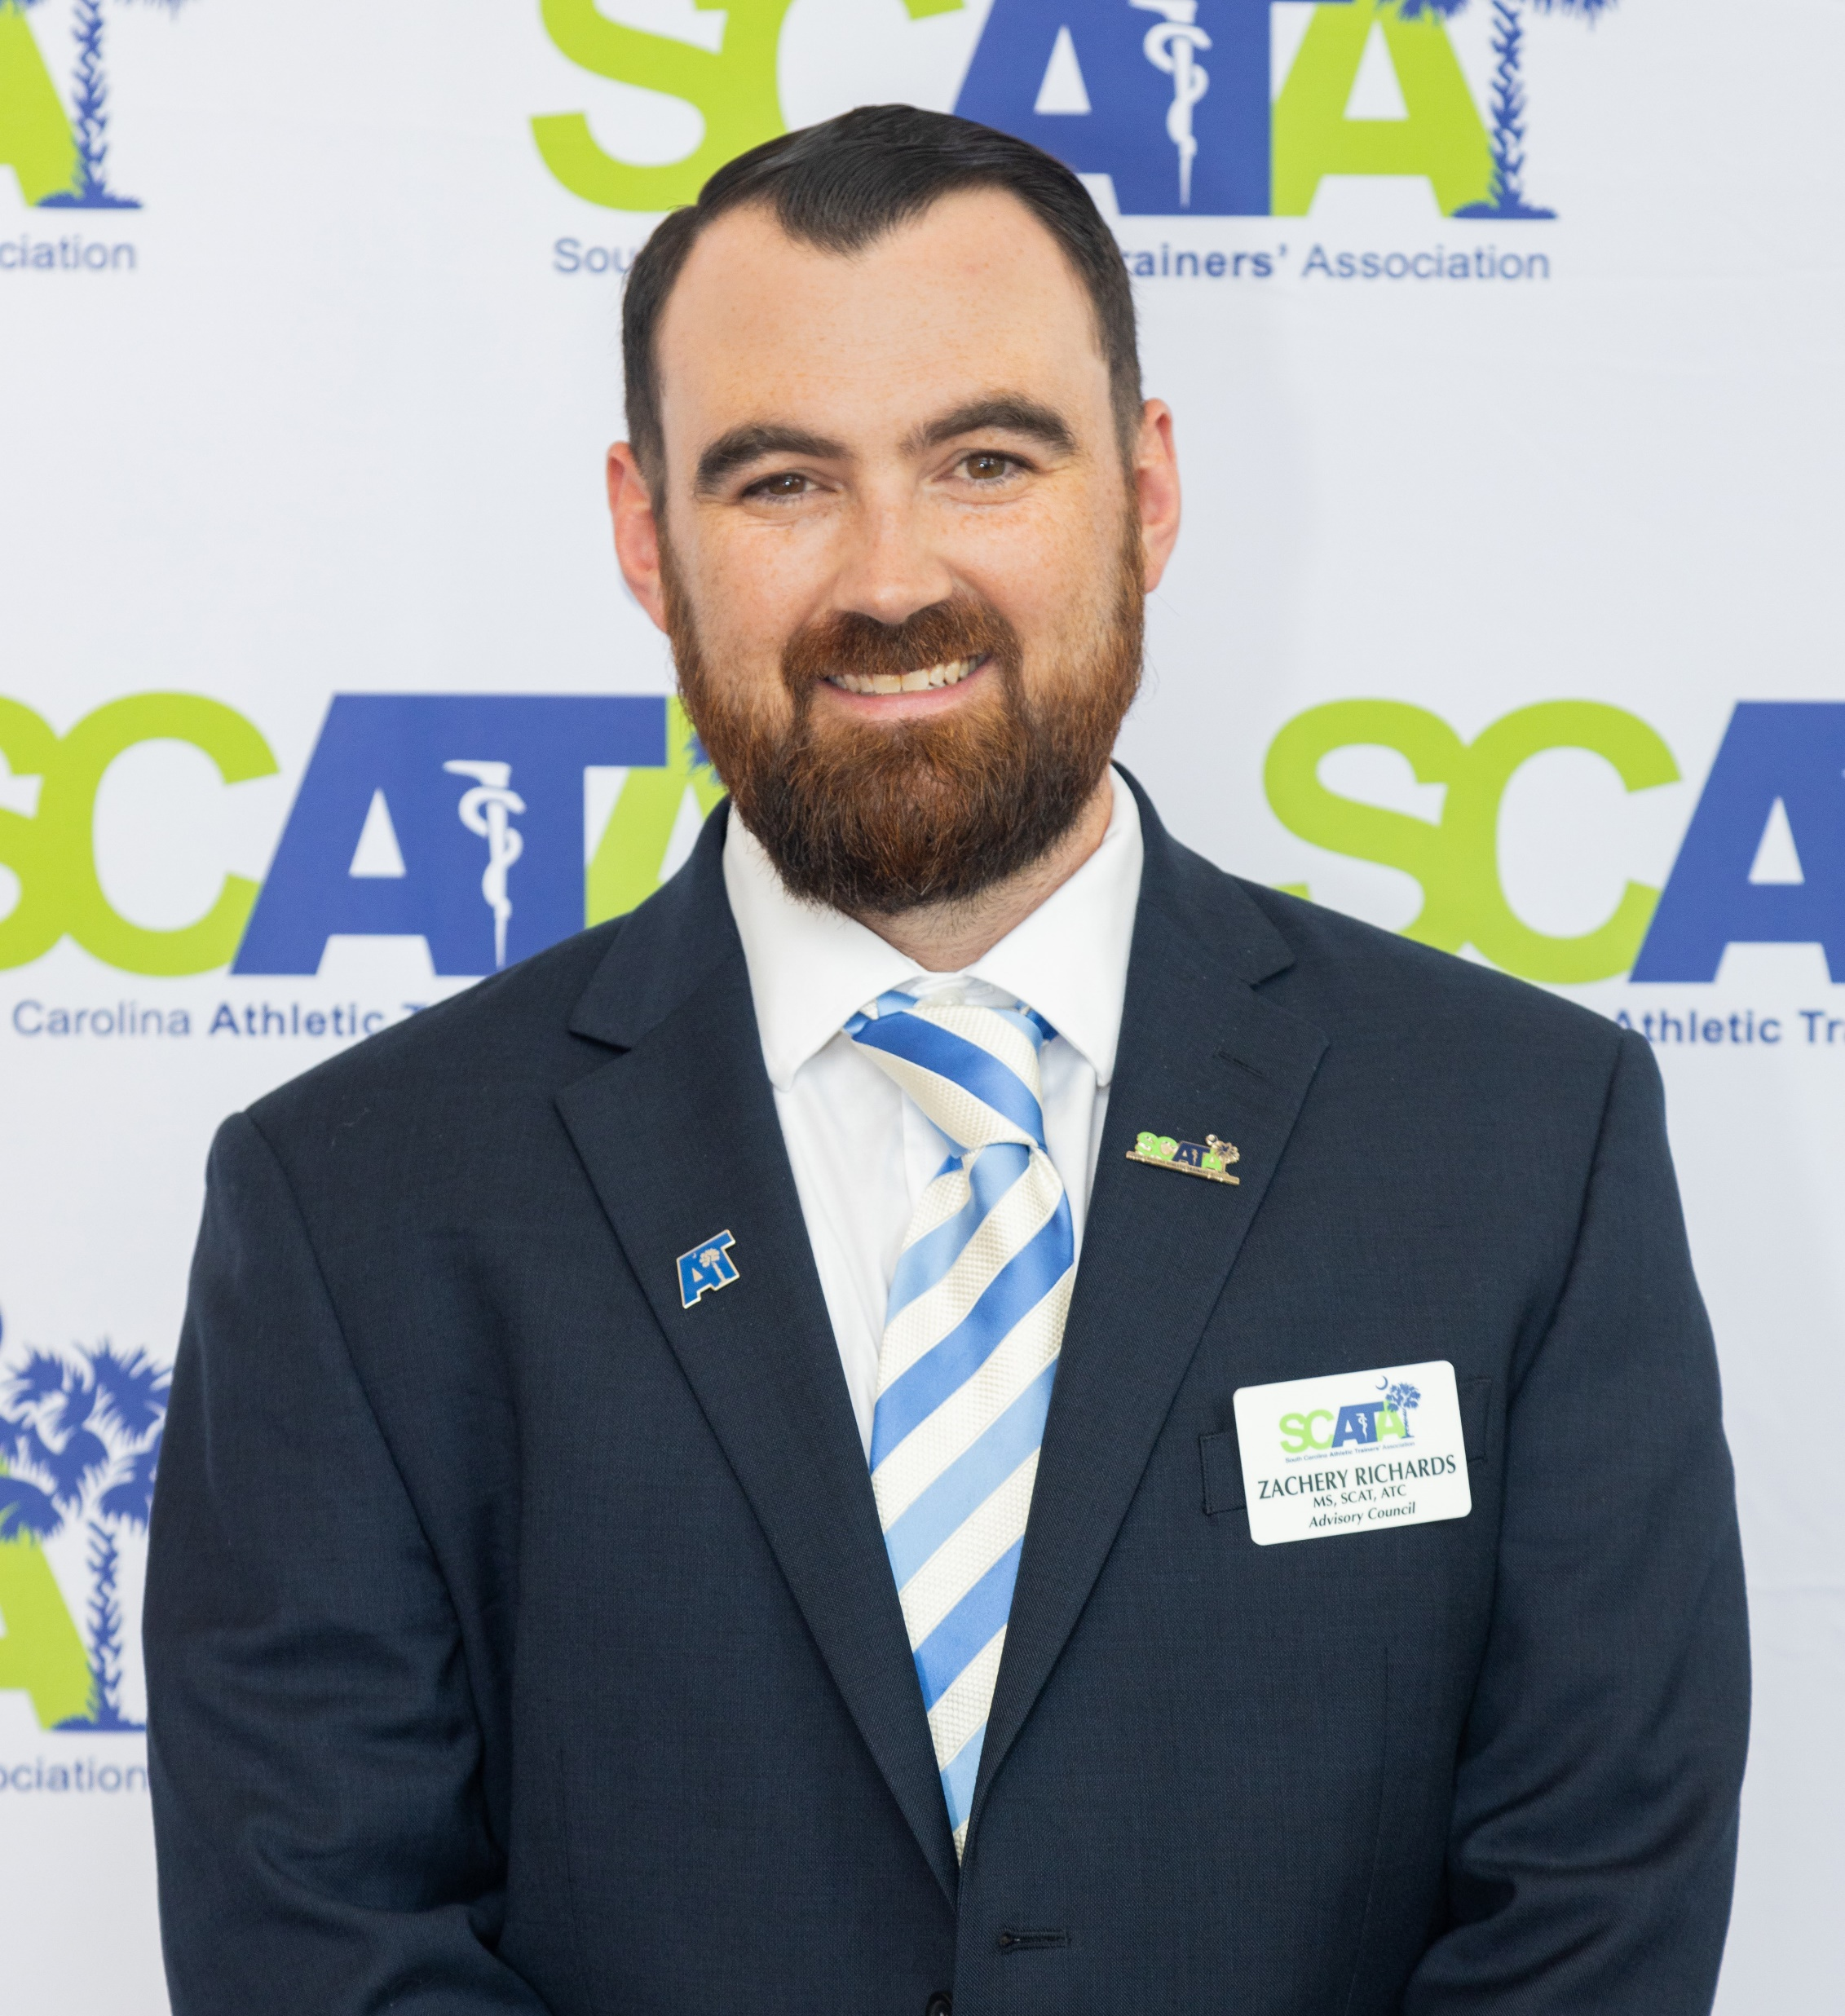
SCATA Athletic Training
Service Award
Zachery Richards, LAT, ATC
Head Athletic Trainer
Pelion High School
Pelion, SC

Slide 13
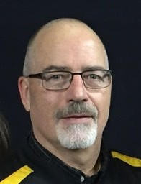
SCATA Athletic Training
Service Award
Mike Smith, AT Ret.
Retired, Head Athletic Trainer
York Comprehensive High School
York, SC

Slide 14
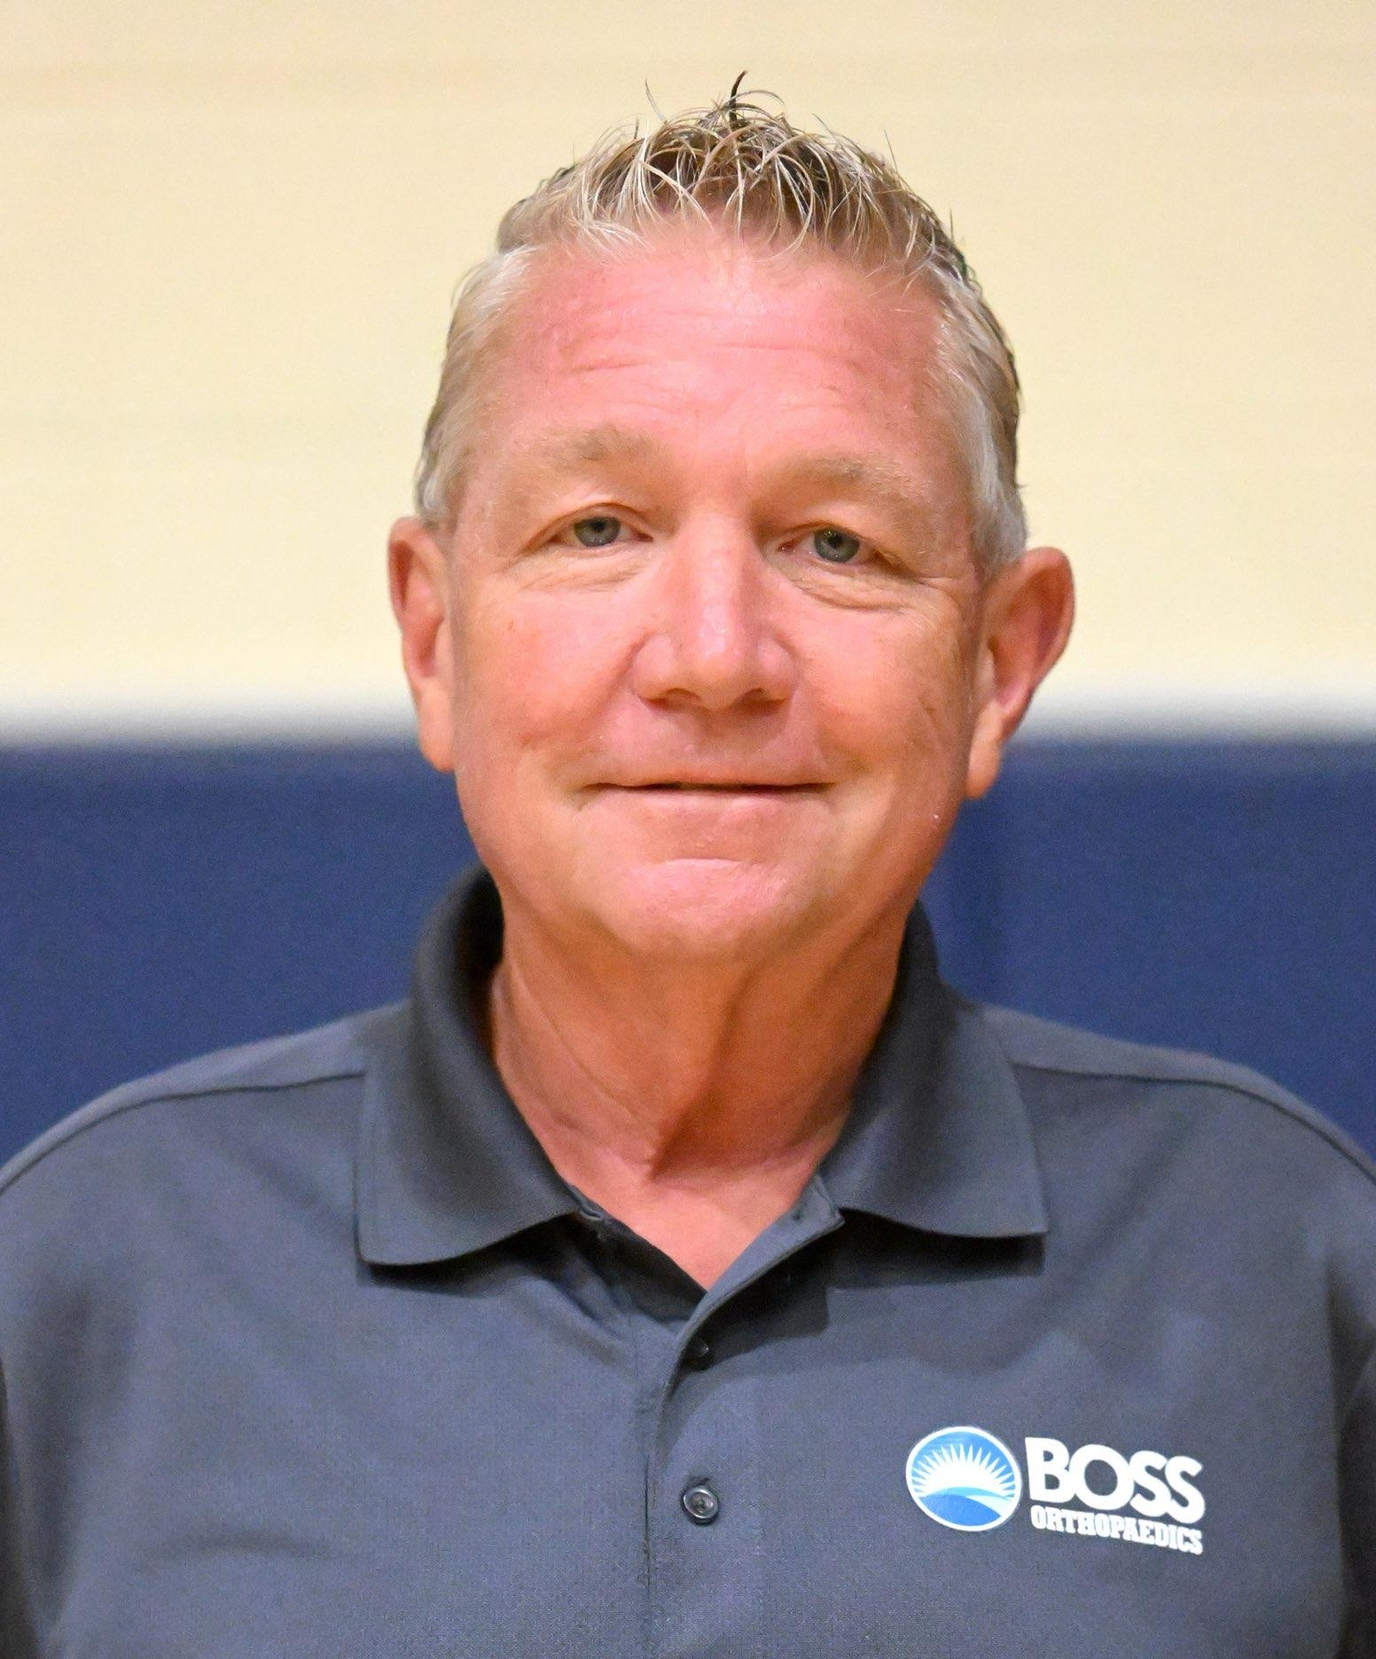
SCATA Athletic Training
Service Award
Shawn Zink, MSS, LAT, ATC
Athletic Training Director
BOSS Orthopaedics
Hilton Head Island, SC

Slide 15
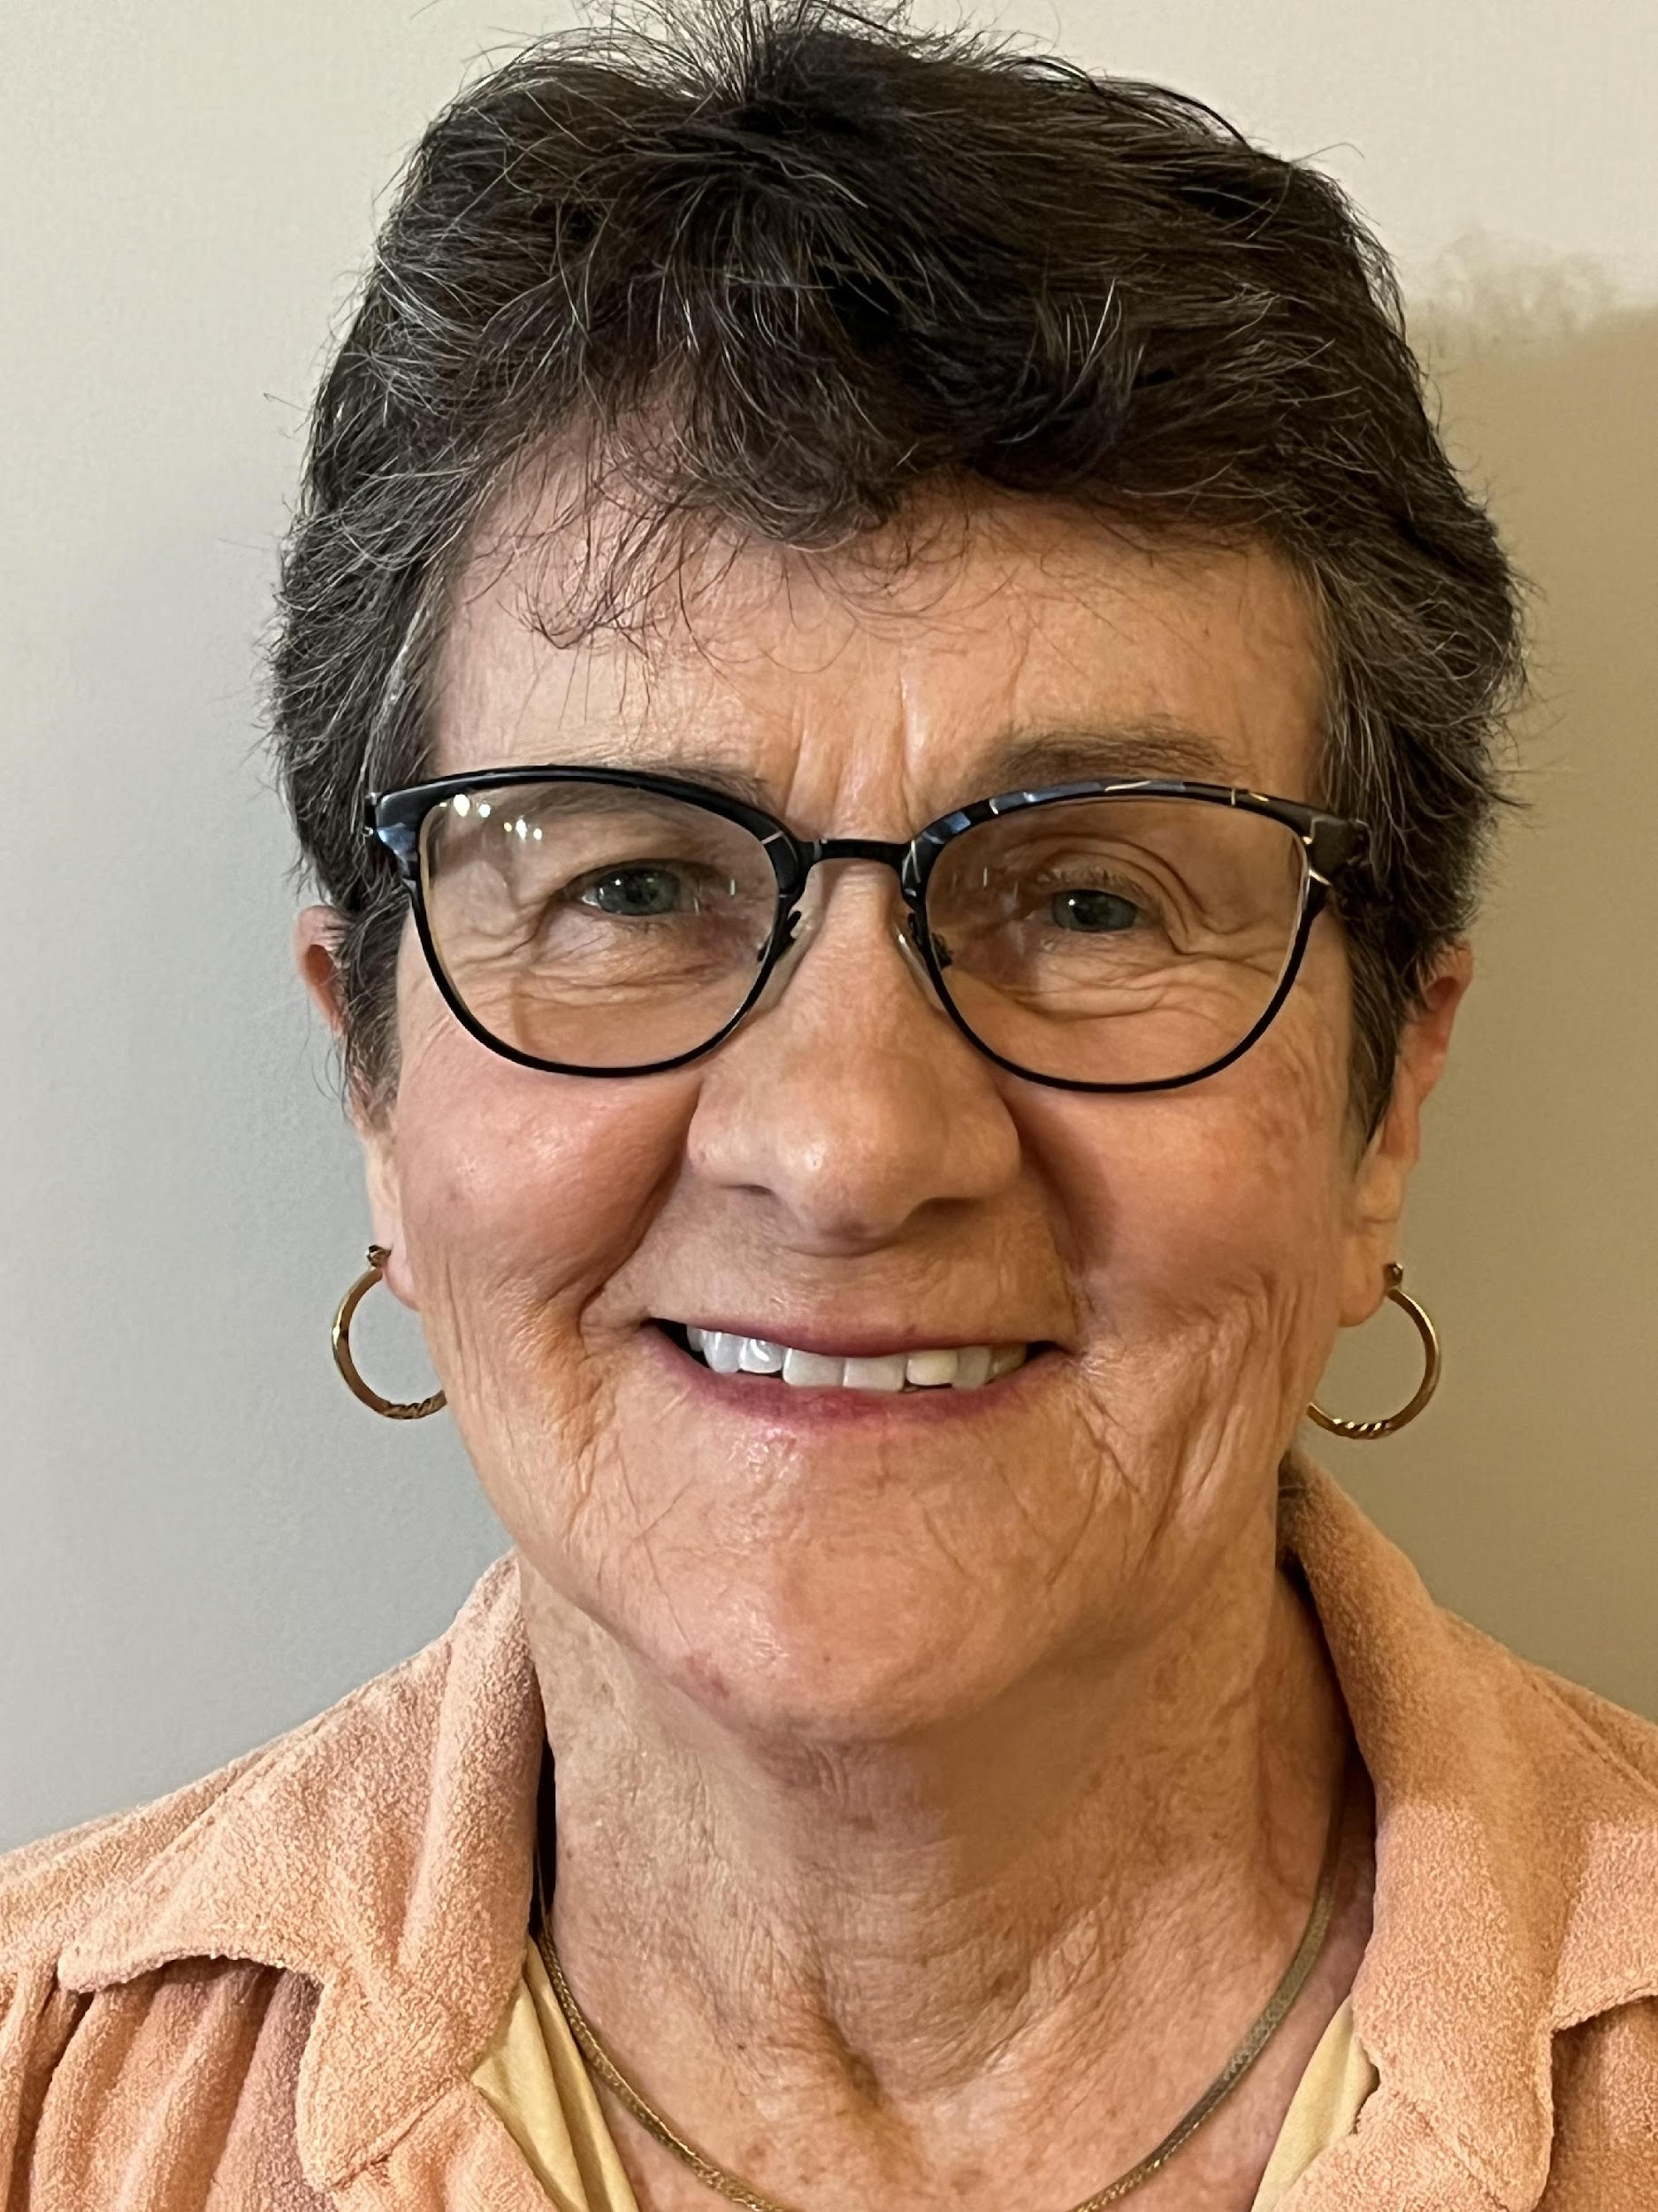
Founders Most Distinguished Athletic Trainer
Jane Steinberg, LAT, ATC
Staff Athletic Trainer
Moore Orthopaedic Clinic
Ben Lippen School
Columbia, SC

Slide 16
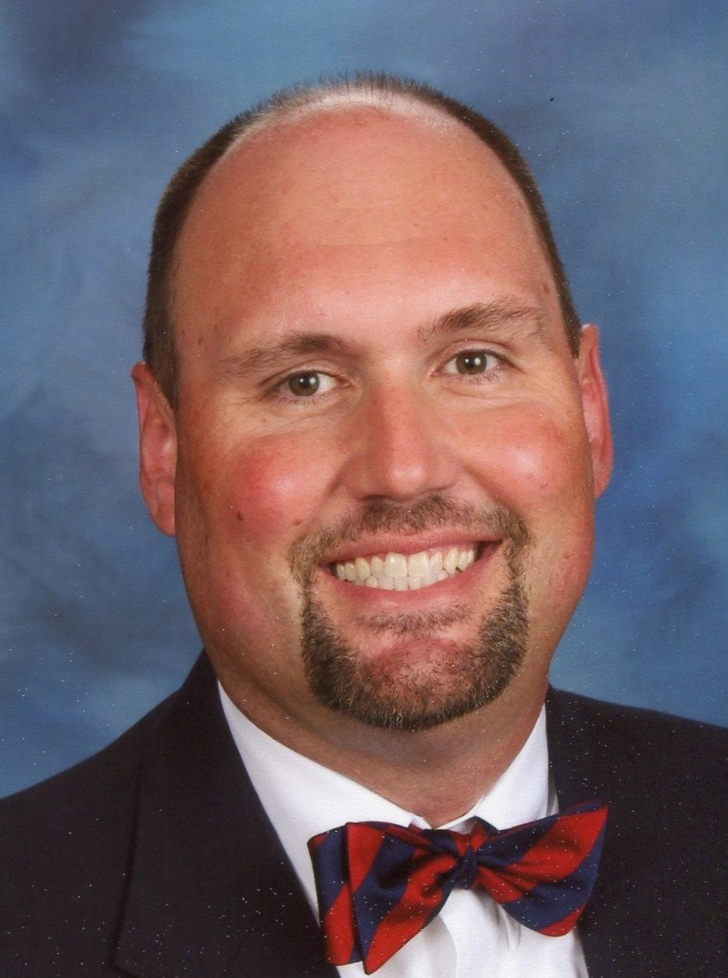
Founders Most Distinguished Athletic Trainer
George S. Wham Jr., EdD, LAT, ATC
Co-Head Athletic Trainer
River Bluff High School
Lexington, SC
Unable to attend this year, so he will be presented with his award in 2026

Slide 17
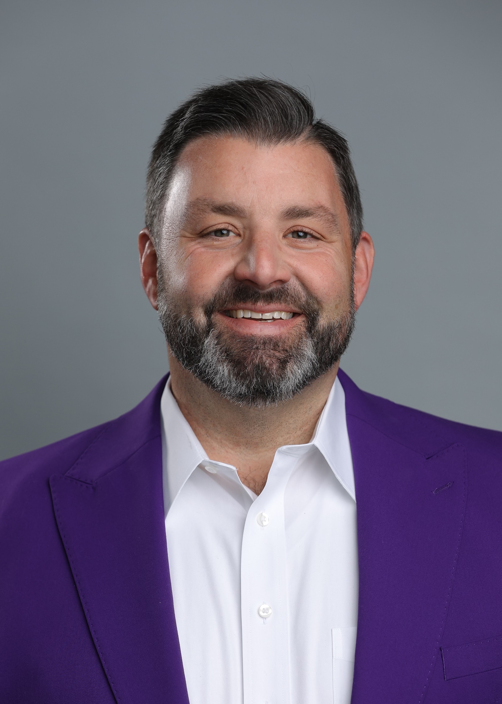
Fred W. Hoover
Award of Excellence
Craig Clark, LAT, ATC
Director of Sports Medicine
Tulane University
New Orleans, LA

Slide 18
Craig would like to recognize and thank…
April Clark, Larry and Barbara Clark, Eddie and Becky Benson, Andy Clawson, Elaine Baker, Jerry Robertson, Jerome “Raz” Razayeski, Bill Warren, Gary Nelson, Barry Atkinson, Kevin Ennis, Nelson Jones, Sheila Gordon, Michelle Lomonaco, Molly Anderson, Gerald Jordan, Joe Whitson, Brad Drake, Will Christman, Mat Lyden, Danny Poole, Donna Bullock, Abby DeDecker, Michelle Futrell, Mike Brown, Krista Gruhn, Kristin Willeford, Whitley Williams, Chris Pare, Jane Steinberg, Mike Smith, Walt Gainey, Mark Buchman, Coaches Daryl Chandler, Don Ward, Tom Heck, Robby Howard, the late Mike LaSorsa, Coach Fred Jordan, Coach Bobby Lamb, Coach Clay Hendrix, Dr. Kenny Caldwell, Dr. Tom Baumgarten, Dr. John Vann, Dr. Jay Womack, The Citadel Athletic Department, Furman University Athletic Department, the SCATA membership, and especially the late, great Fred Hoover.

Slide 19
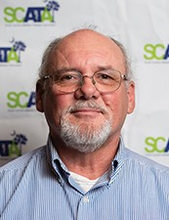
Fred W. Hoover
Award of Excellence
Walt Gainey, AT Ret.
Retired, Head Athletic Trainer
Rock Hill High School
Rock Hill, SC

Slide 20
Walt would like to recognize and thank…
My Lord and Savior Jesus Christ
The Late Fred Hoover
SCATA and the Honor and Awards Committee
My Wife Cathi along with my children
Kevin Ennis, Mike Smith, Sheila Gordon, Ernie Drews, Jim Berry, Keeter Hayes, Barry Atkinson, Gary
Nelson, Joe Kinney, Andy Clawson, Bill Warren, and a whole host of other A.T.,C.’s around our State
The Late Terry Lewis
Rock Hill High School, Chester High School and Winthrop University
Dale and Betty Gainey
Jim Ringer, Billy Parker, and the late Wayne McIntosh

Slide 21
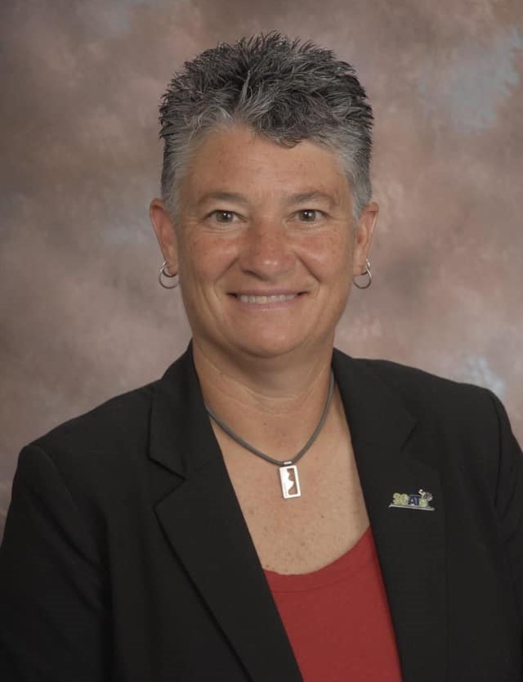
Fred W. Hoover
Award of Excellence
Sheila Gordon, LAT, ATC
Head Athletic Trainer
White Knoll High School
Lexington, SC

Slide 22
Sheila would like to recognize and thank…
God for Giving me my talents and gifts
Family and Friends that sometimes have taken the back seat
Nominator - Mike Ryan
Honors and Awards Committee
Executive Committee - Past and Present
Work Colleagues Team Physician - Mickey Plymale and Nikki Chosen
Family - ATs are family
Byrnes and White Knoll Coaches and Players
Vendors that have become friends
All the connections I’ve made along the way
The high school student trainers that are now colleagues
The collegiate student trainers that I’ve had a chance to influence
Finally, the ATs that I haven’t met yet that will forever influence our great profession

Slide 23
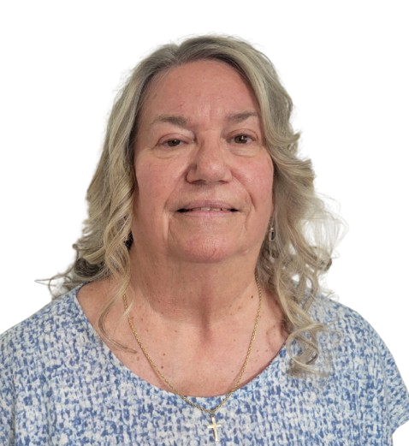
Fred W. Hoover
Award of Excellence
Sheila Romano, LAT, ATC
Retired, Athletic Trainer
Dorman High School
Roebuck, SC

Slide 24
Sheila would like to recognize and thank…
My family, including Lee Curry, Wayne Curry, and my husband Bill Romano for their support and patience with the long hours and days of games and meetings over the past 42 years of my career.
Alendale-Fairfax High School for allowing me to be their first athletic trainer, teacher, and girls’ basketball coach.
Mickey Sobeski for bringing me to Dorman High School.

Slide 25
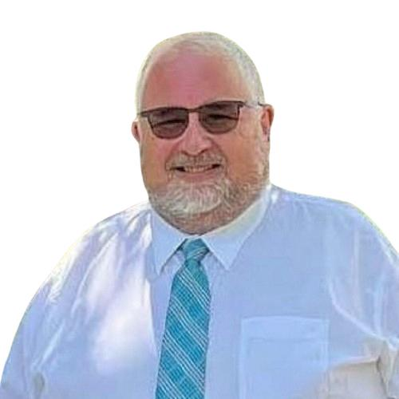
Fred W. Hoover
Award of Excellence
Dr. Jim Berry, LAT, ATC
Retired, Head Athletic Trainer
Conway High School
Conway, SC

Slide 26
Jim would like to recognize and thank…
My wife Becky, son Cooper, and my late son Carson for their love, support, and patience during all those times I could not be there for them, because I was there for others.
My nominator, colleague and friend…Andrea Owens…we’ve been through some tough times but you gave me grace.
Mr. Fred Hoover for being one of the very first people to welcome me to South Carolina and for his wisdom and mentorship over the years.
Mr. John Lopez for his friendship and mentorship over the years.
Mr. Andy Clawson for his mentorship and support during a very difficult time in my professional life.
Dr. Joe Kinney, Mr. Ernie Drews, and Mr. Keeter Hayes who welcomed me to Horry County in 1991 and have been lifelong colleagues and friends since then. We’ve been through thick and thin!
The hundreds of fellow South Carolina Athletic Trainers I have met and worked with during my career. My family and I will always remember the love and support that was shown our family when we lost Carson.
My fellow HCS Athletic Trainers over my 31-year career – not enough space to name them all here!
All of the coaches whom I have had the pleasure of working with over the years.
All the parents and athletes over the years who have entrusted me to provide medical care.
The Bourbon Brothers – working together to give back to the association we all love!

Slide 27


Congratulations,
everyone!

Slide 28

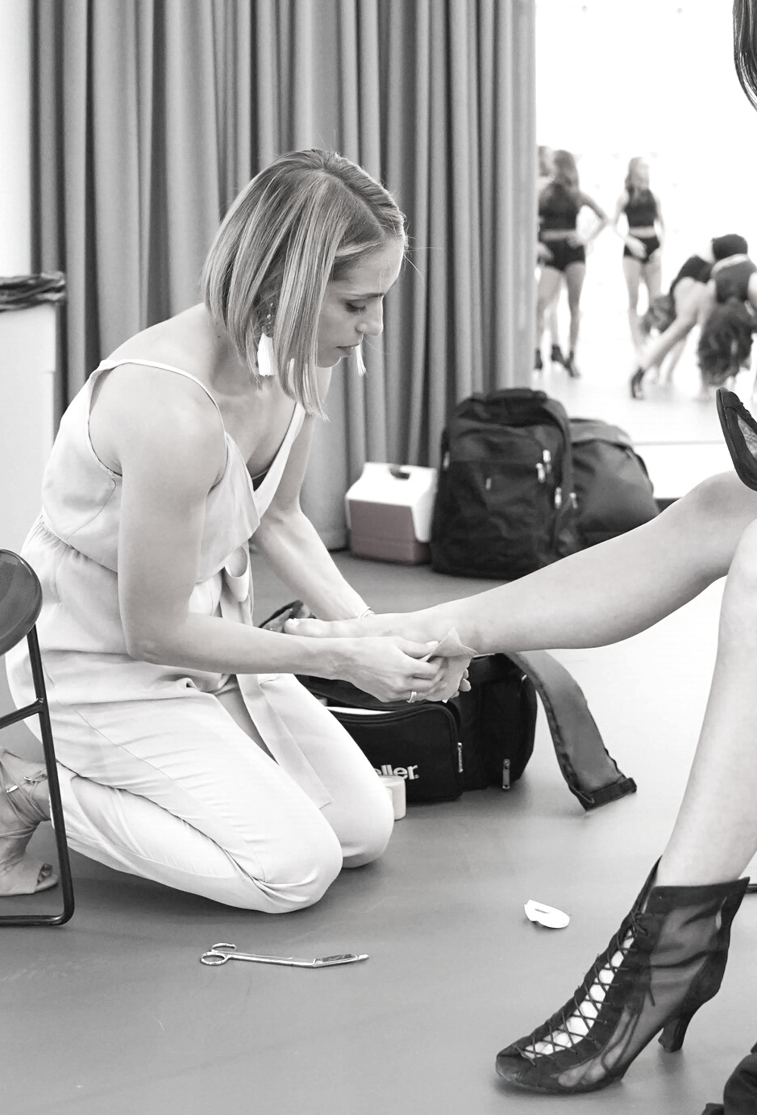
South Carolina Athletic Trainers' Association
2025 ANNUAL SYMPOSIUM
BUSINESS MEETING

Slide 29
Outline
Welcome
Call to Order
Approval of Minutes from 2024 Business Meeting
  Motion: Matt Lyden
  Second: Sheila Gordon
NATA/MAATA Update
Officer Reports
New Business
Adjourn
  Motion: Berry Atkinson
  Second: Sheila Gordon

Slide 30
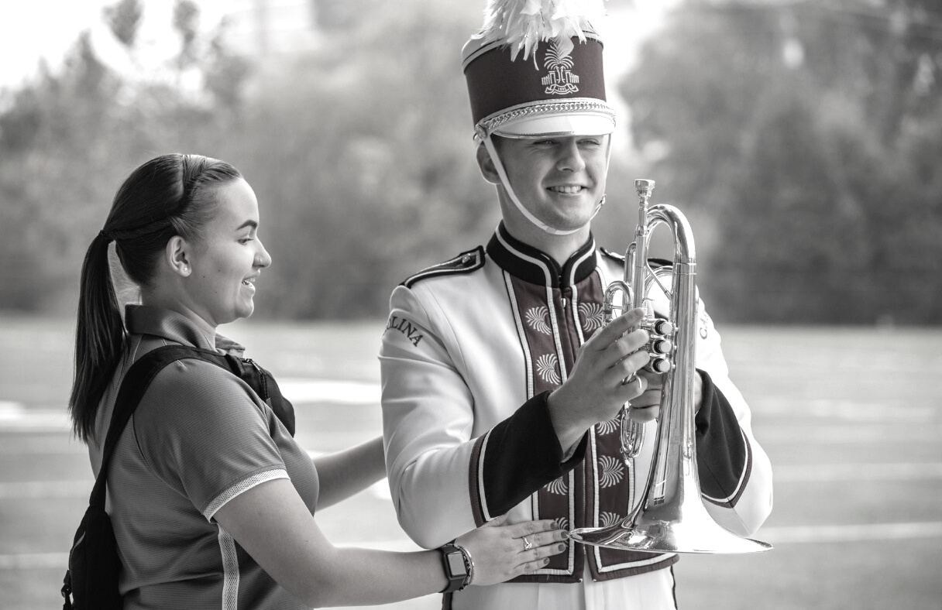
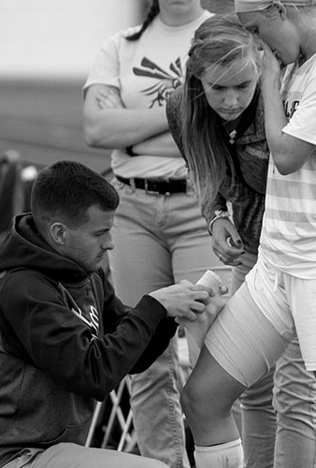
APPROVAL OF 2024 MINUTES

Slide 31
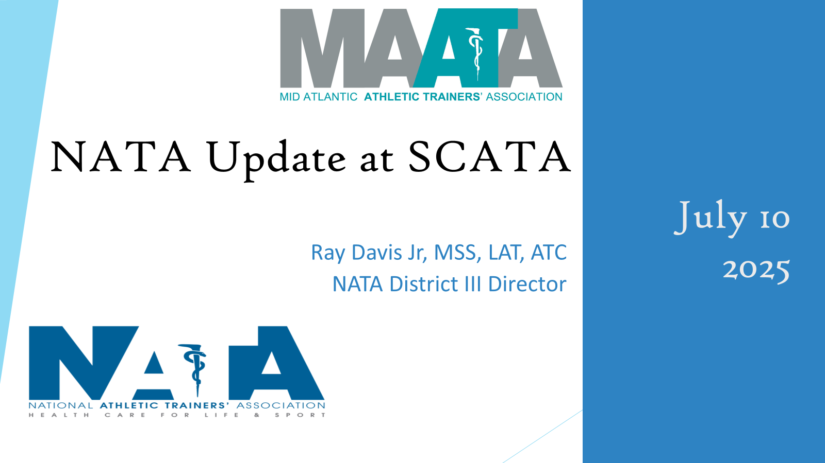

Ray Davis
D3 District Director

Slide 32


Slide 33


Slide 34
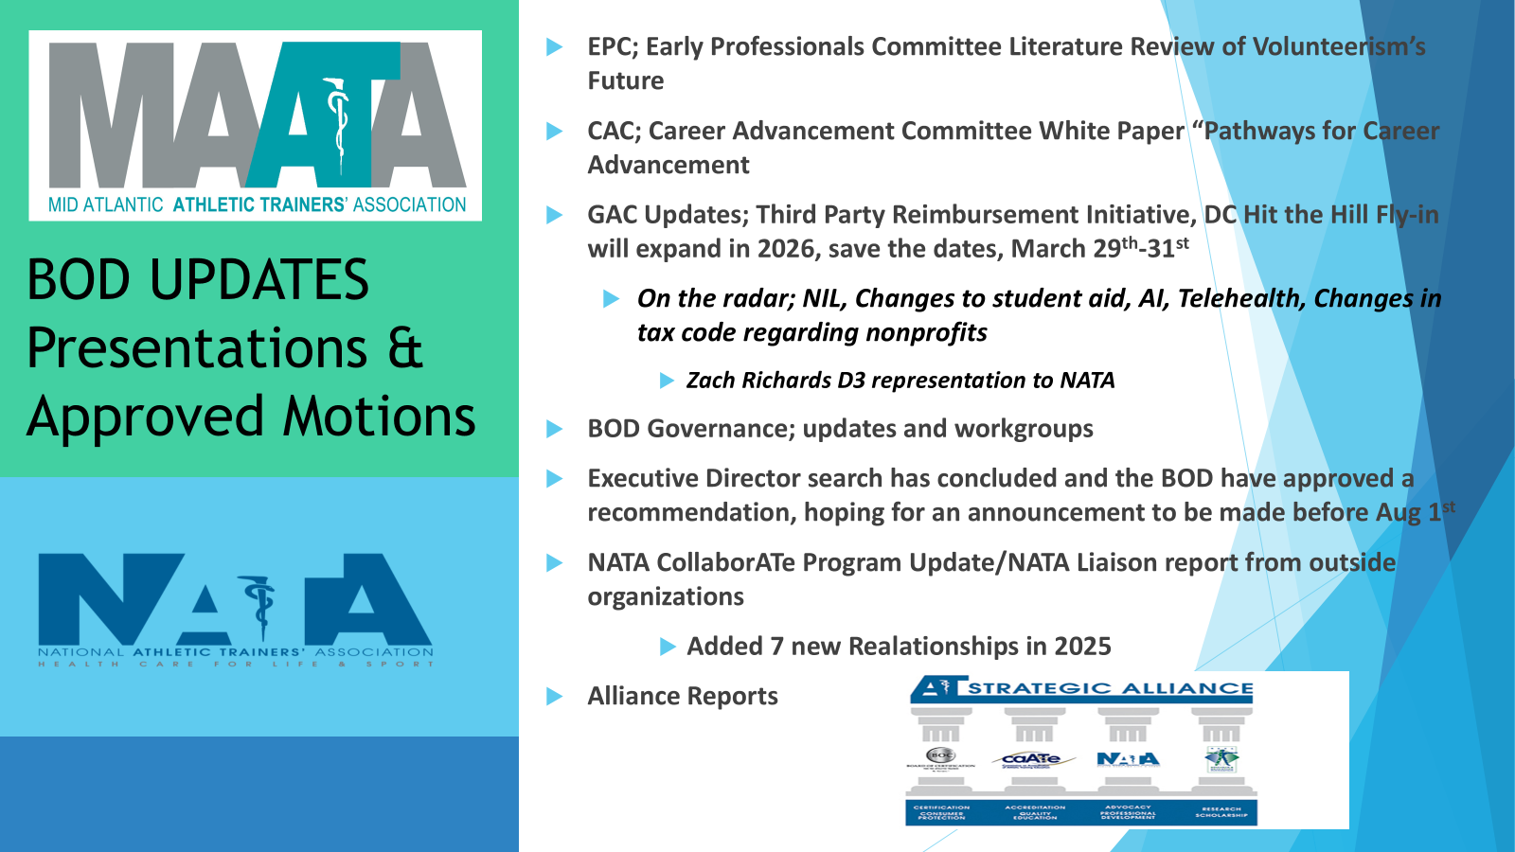

Slide 35


Slide 36
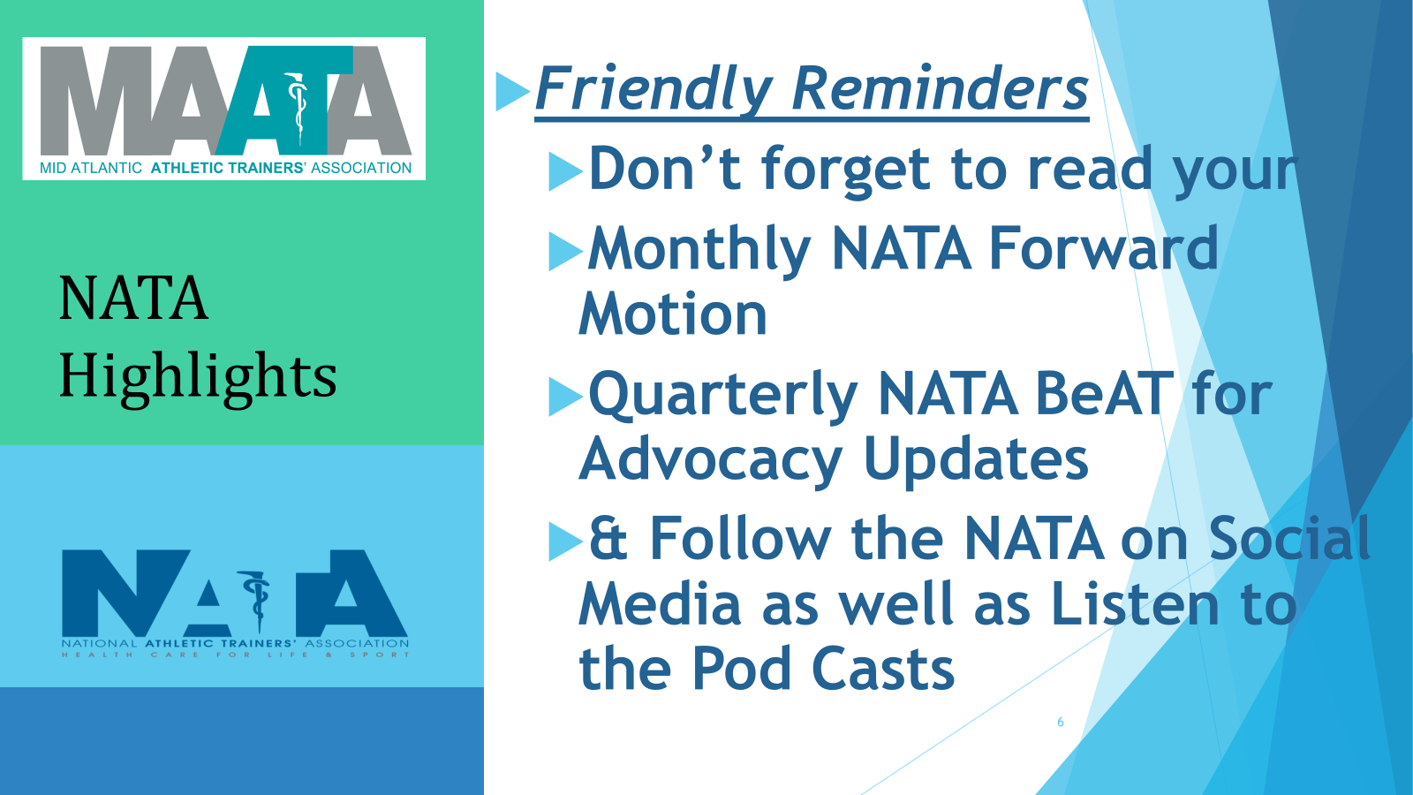

Slide 37


Slide 38
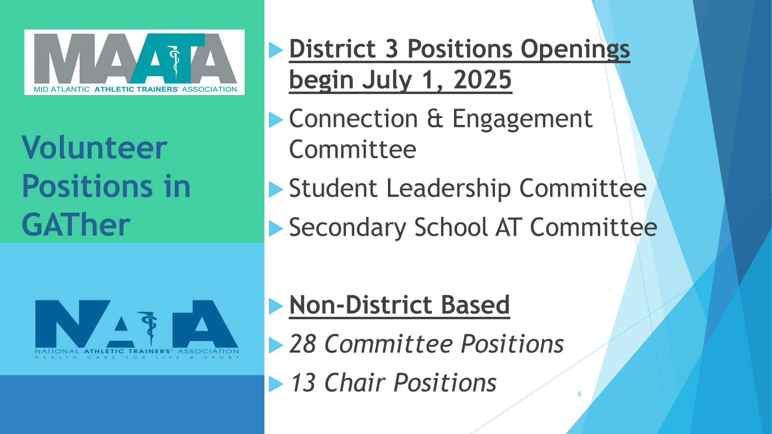

Slide 39
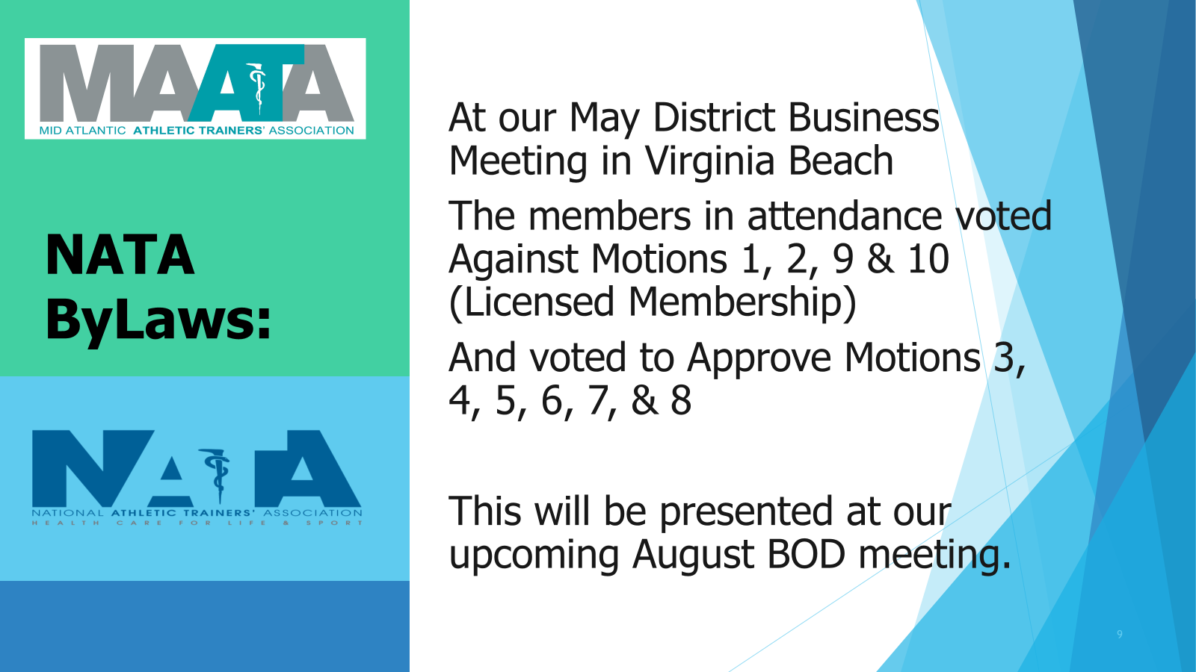

Slide 40


Slide 41


Slide 42


Slide 43
Matt Gage
MAATA President

Slide 44
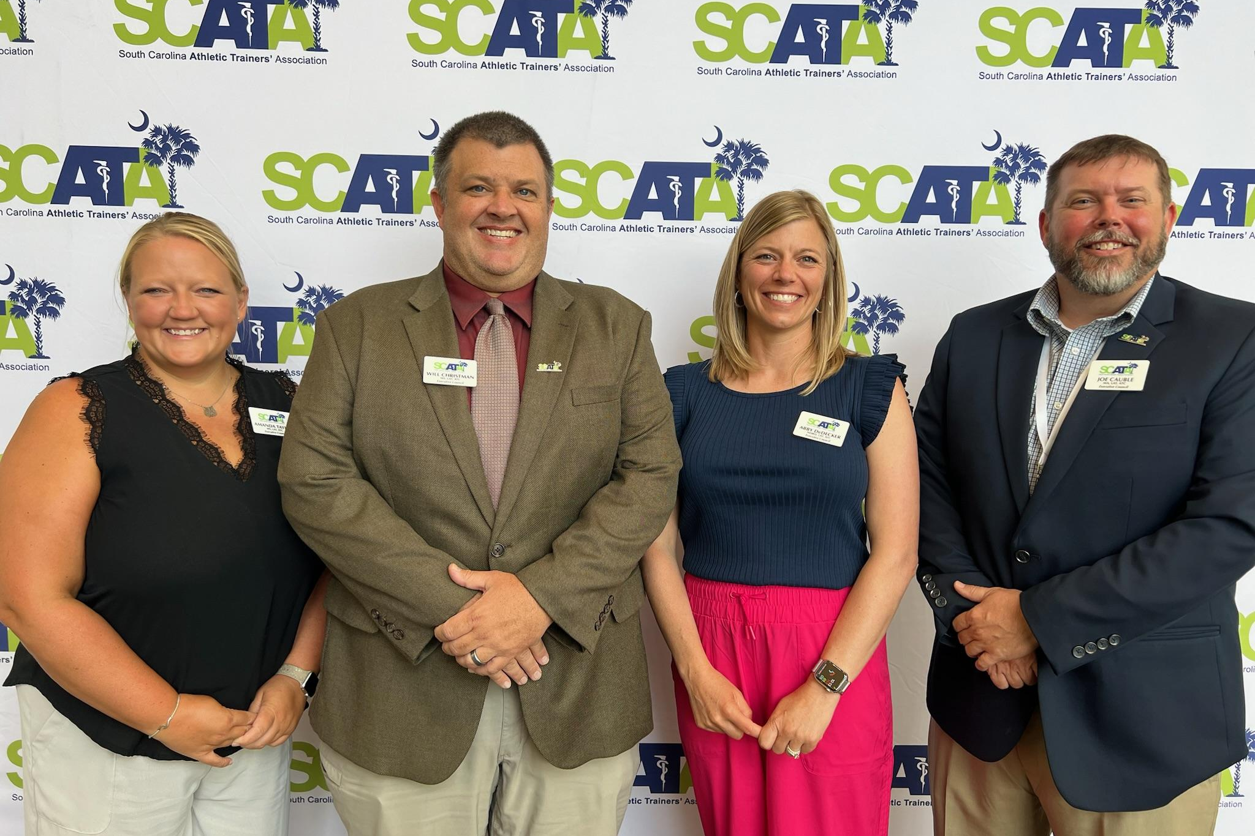
REPORTS OF OFFICERS
SECRETARY
TREASURER
PRESIDENT-ELECT
PRESIDENT

Slide 45
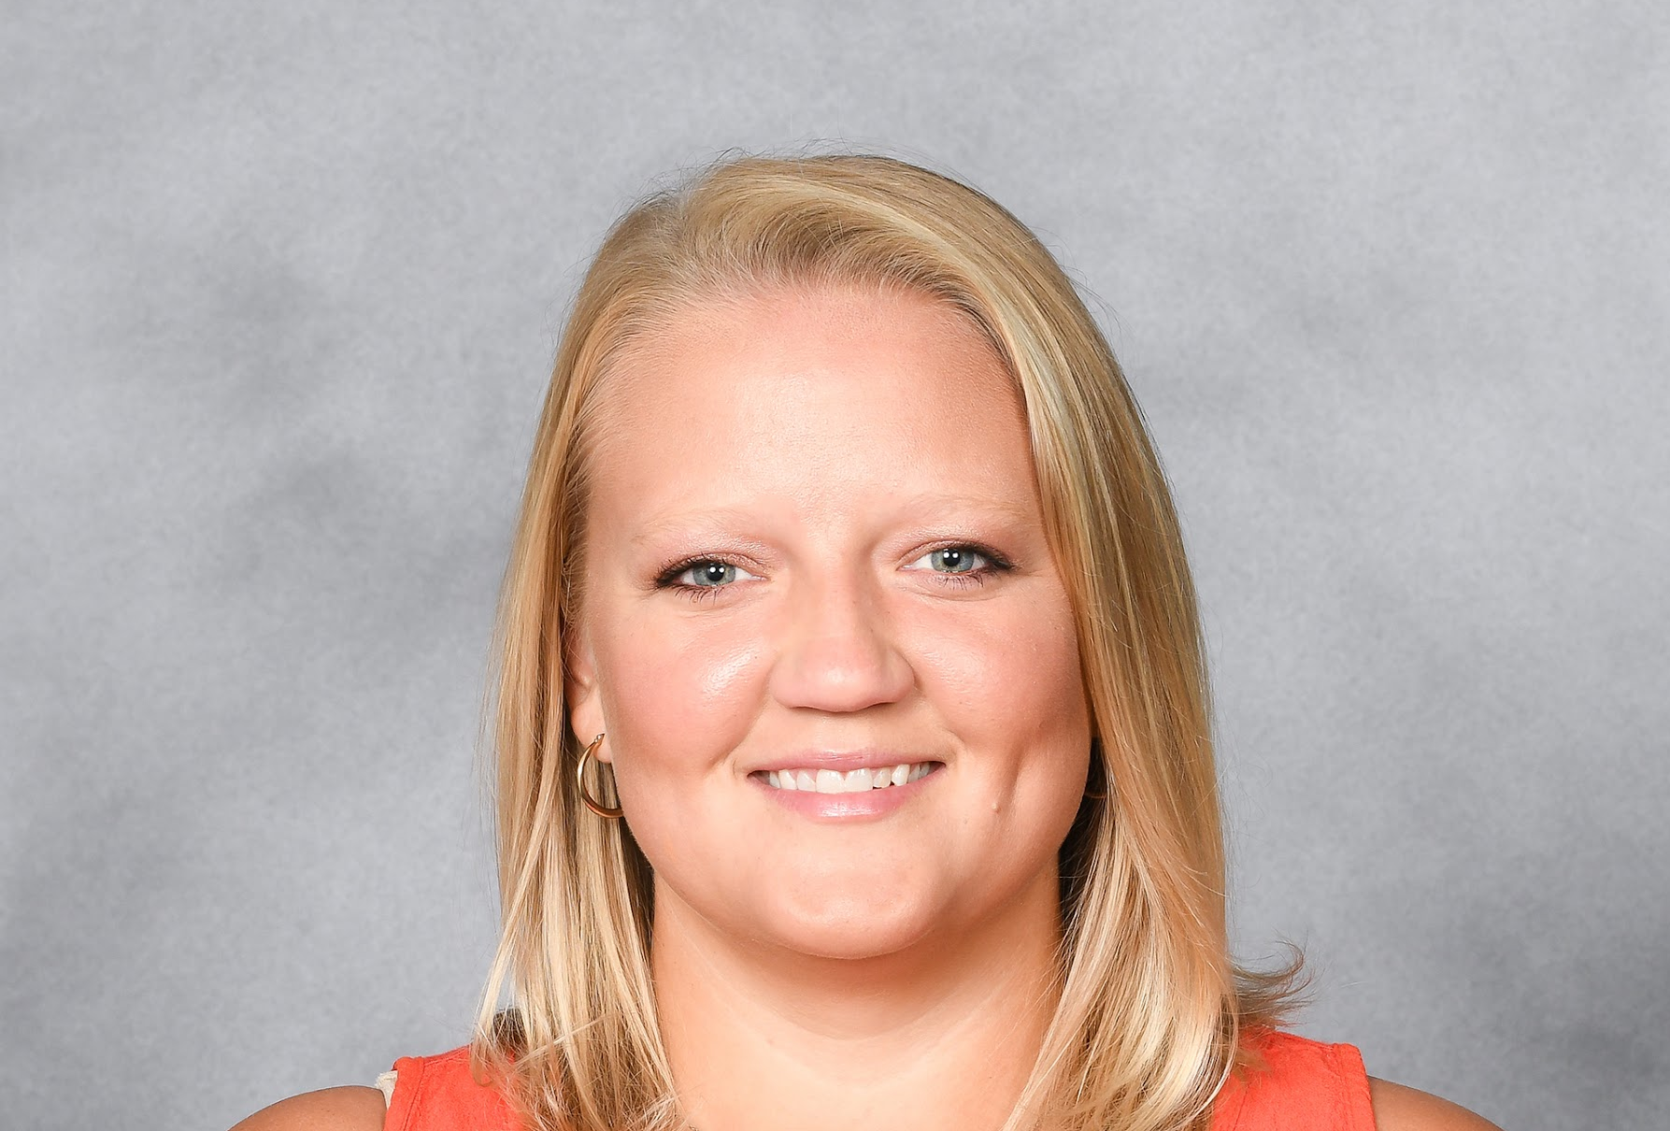
SECRETARY
Amanda Taylor MS, LAT, ATC

Slide 46
SECRETARY REPORT
Membership Dues
$30.00 Annually (increasing to $50.00 in 2026)
NATA members with a South Carolina address will have funds automatically routed to SCATA
  Update your addresses, email address
Non NATA members renew through SCATA
  Renew Jan of each year
  Accounts will be suspended in March if not paid (60 day grace period)
Retirees
  Send an email to secretary@scata.org

Slide 47
SECRETARY REPORT
Membership Numbers
7/9/25
Classification NATA Non-NATA
Certified (SC resident) 495 (+35) 69
Certified (Student) 73 1
Retired 52
Student (SC resident) 23 2
Associate (SC Resident) 6 5
Total 649 77 726

Slide 48
2025 MAATA and NATA Awards
Most Distinguished Athletic Trainer
Susan Yeargin
Jim Mensch
Toni Torres-McGhee
NATA SAAC Emerging Leader Award
Zach Richards
NATA SSATC AT Of The Year - D3
Sheila Gordon
NATA Preceptor Of The Year
Jonathon Jenkins
NATA Emerging Educator Award
Zachary Winkelmann

Slide 49
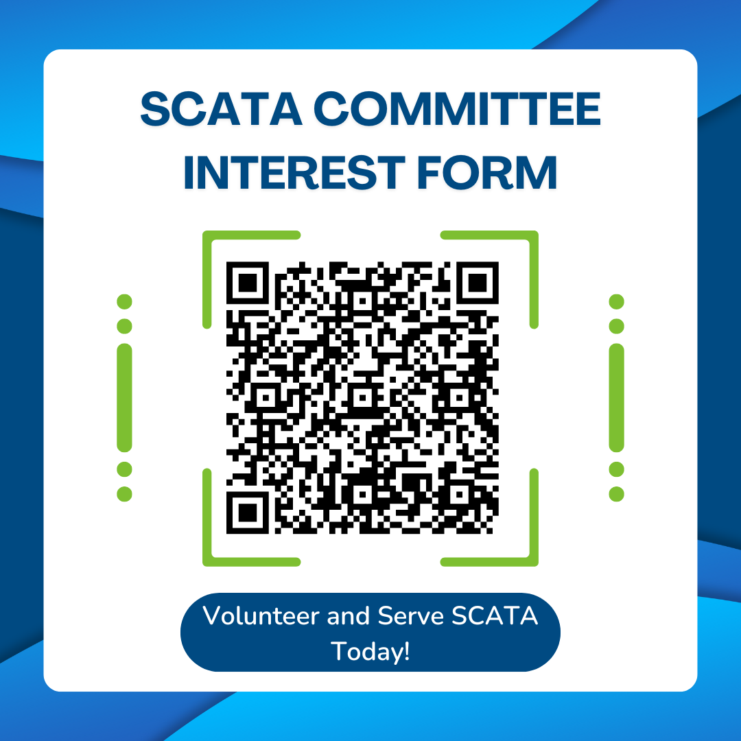

Slide 50
LLR / DHEC Verifications
SCATA cannot provide certification or license verifications
We have added the online verification links to our website
https://scata.org/Verification_
Lost SCATA CEU Card
Misplaced your CEU card, email support@scata.org
Not Receiving SCATA Emails
Email secretary@scata.org
SCATA Profiles
Update your SCATA profile yearly (Name, Address, Setting)

Slide 51


Slide 52
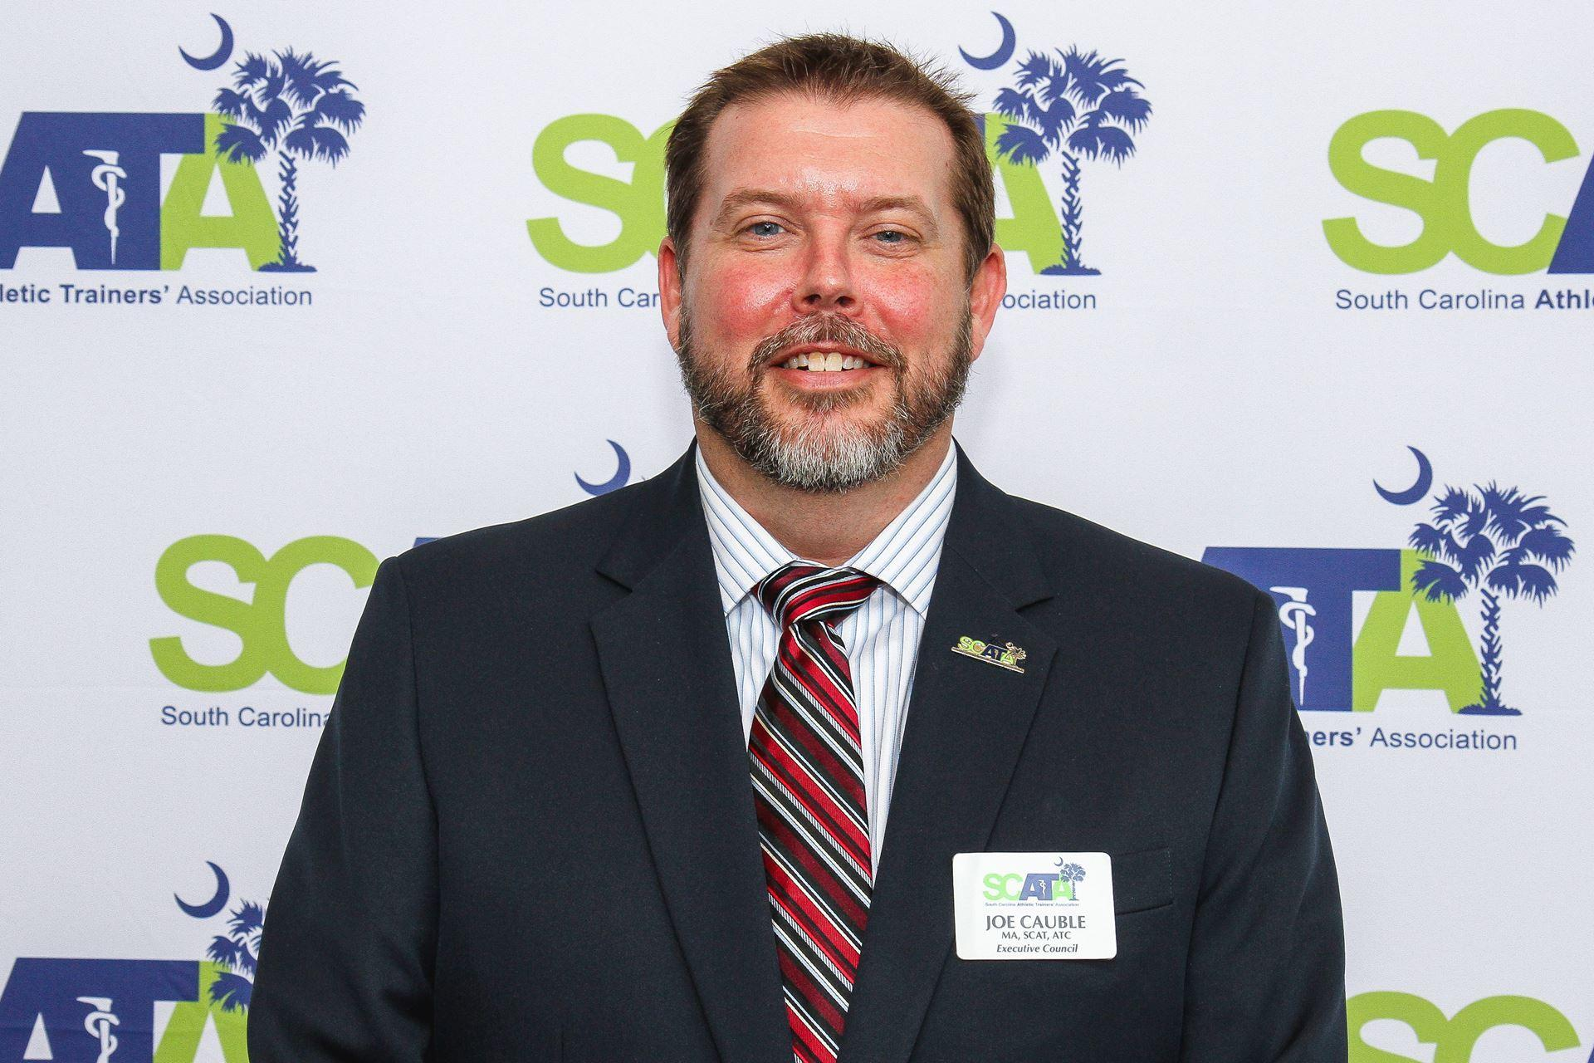
TREASURER
JOE CAUBLE, MA, LAT, ATC
McLeod Health

Slide 53
ASSETS
Current Assets
Bank Accounts
Checking | $ 41,587.96
Money Market | $ 108,337.34
Total Bank Accounts | $ 149,925.30
Total Current Assets | $ 149,925.30
TOTAL ASSETS | $ 149,925.30
LIABILITY AND EQUITY
Total Liabilities
Equity
Opening Balance Equity
Retained Earnings | $ 91,213.02
Net Income | $ 58,712.28
Total Equity | $ 149,925.30
TOTAL LIABILITIES AND EQUITY | $ 149,925.30
Balance Sheet
As of July 9, 2023
TREASURER REPORT

Slide 54
Expenses | FY Actual
Annual Symposium | $ 71,518.89
Committee Expenses | $ 22,596.37
Insurance | $ 2,937.00
Miscellaneous | $ 629.52
Office Supplies & Software | $ 3,931.99
Professional Services | $ 34,100.00
Travel/CE | $ 2,466.80
Web Services | $ 2,792.88
Total Expenses | $ 140,973.45
Income | FY24 Actual
Grants/Fundraising | $ 1,031.62
Interest | $ 467.27
Membership Dues | $ 16,996.27
Miscellaneous | $ 87.87
Scholarship Donations | $ 5,222.50
Sponsorships | $ 21,172.88
Symposium/Workshop Registrations | $ 66,358.67
Total Income | $ 111,337.08
Net Income | $ - 29,636.37
TREASURER REPORT

Slide 55



Fundraising 2024-2025
2024 Bourbon Raffle
July 2024
$ 5,199.00
SCATA Scholarship Fund
Little Caesars Pizza Sales
Fall 2024
$600 raised
Got Sneakers Donation
March 2025- Current
$575 raised

Slide 56

Fundraising 2024-2025
Friends of SCATA Campaign
March 2025 - Current
$ 3,033.35
SCATA Store
July 2024 - $87.87
March 2025 - $49.69

Slide 57
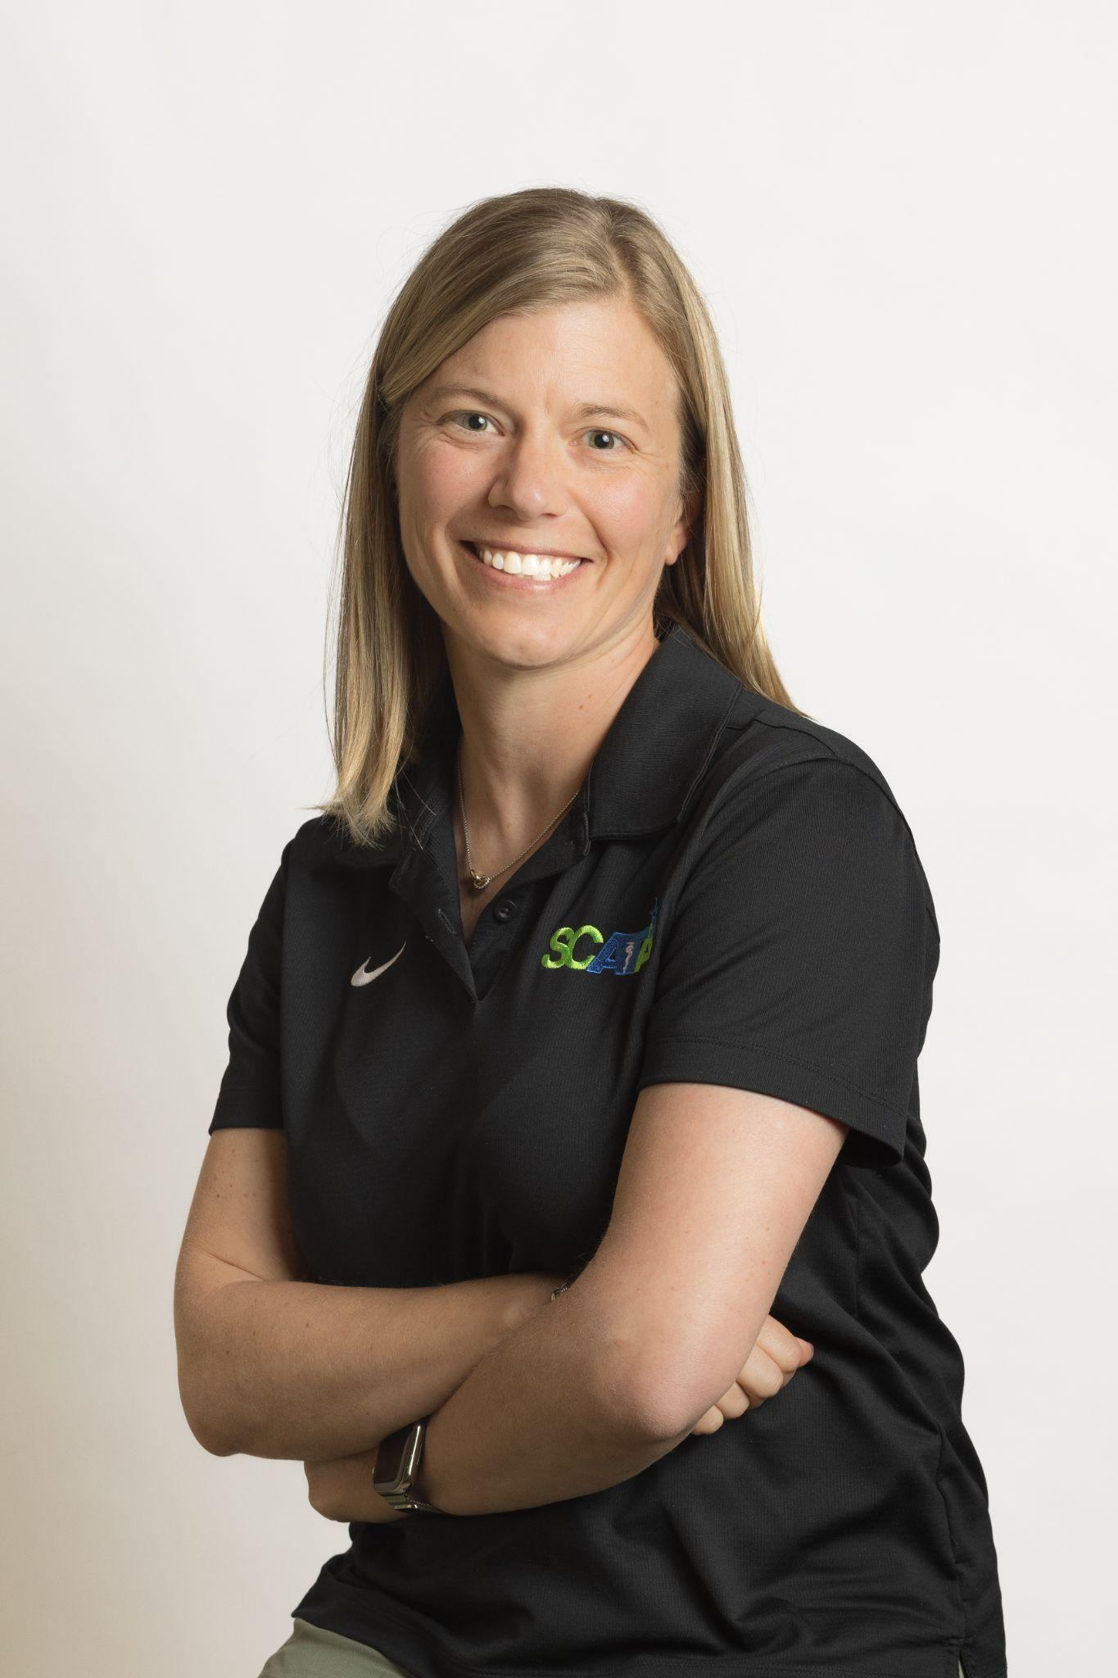
PRESIDENT-ELECT
Abby DeDecker, MHRD, LAT, ATC

Slide 58
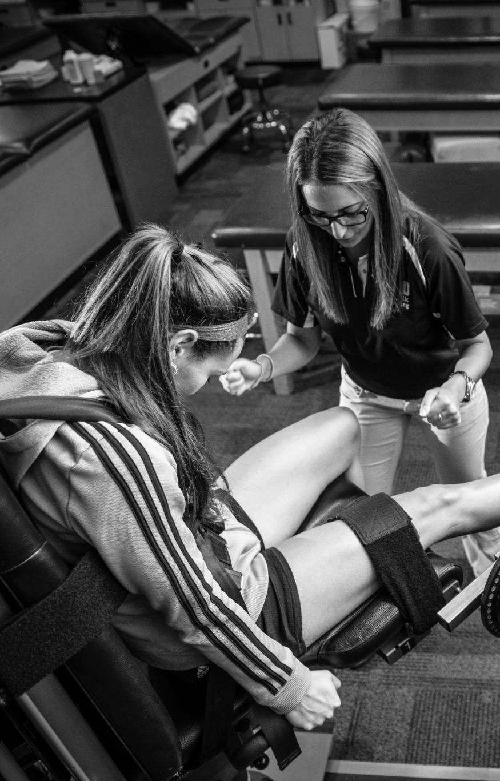
Annual Symposium
Total Registrations:
(7/10/2025)
Certified SCATA Member: 303
Certified Non-SCATA Member: 96
Student SCATA Member: 54
Pre Con Mock Trial - 84
CEU Credits
Symposium - 13 Cat A
Pre - Con - 2 Cat. A
LLR: 2
Free Communications: 10 Posters, 8 oral presentations

Slide 59

Friends of SCATA Campaign
Champion Level Donors
Atlantic Coast Orthopedic Resources Inc. (ACO Med Supply)
Alan Livingston (OROTHMED)

Slide 60


Slide 61


Slide 62


Slide 63
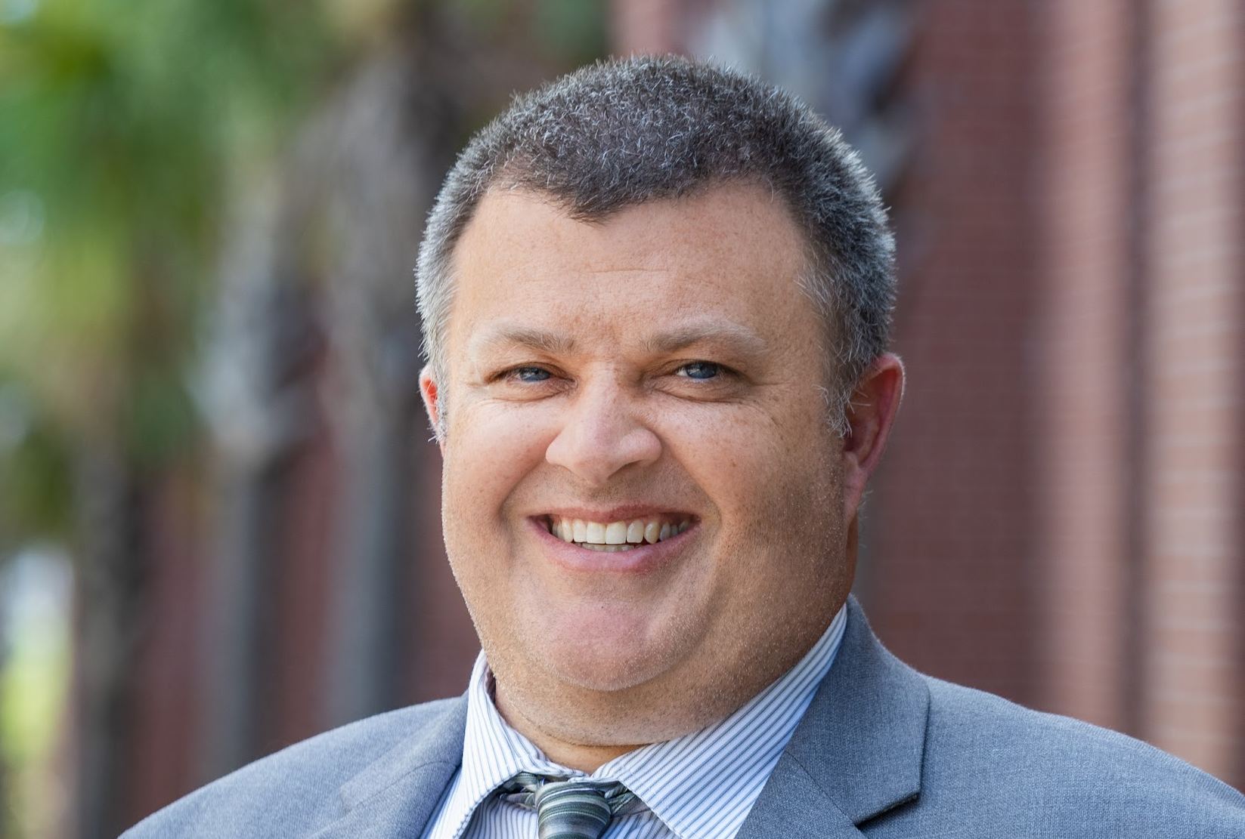
PRESIDENT
Will Christman MS, LAT, ATC

Slide 64
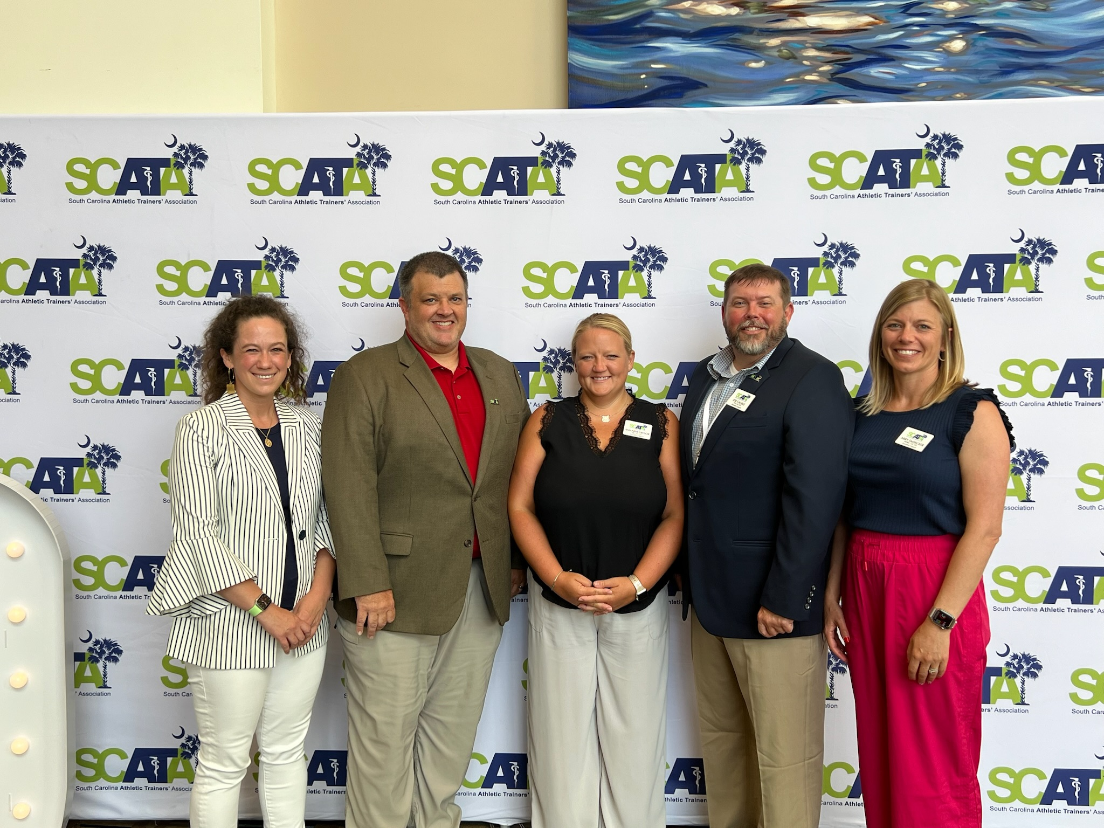
2024-2025 Year in Review

Slide 65
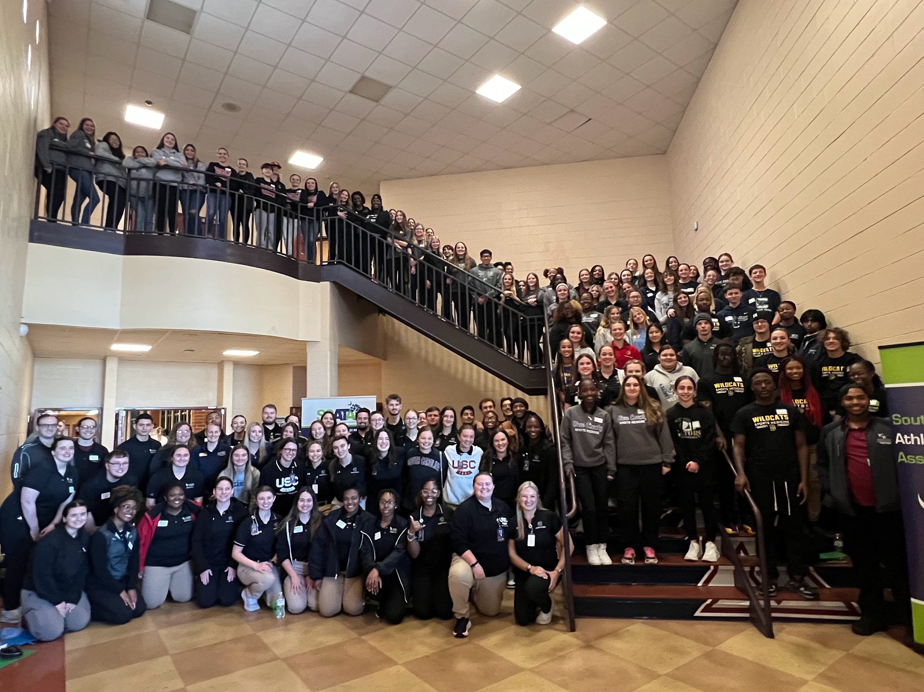
Secondary School WorkShop
200 Pre-registered HS students
Certified members earn CEU’s

Slide 66
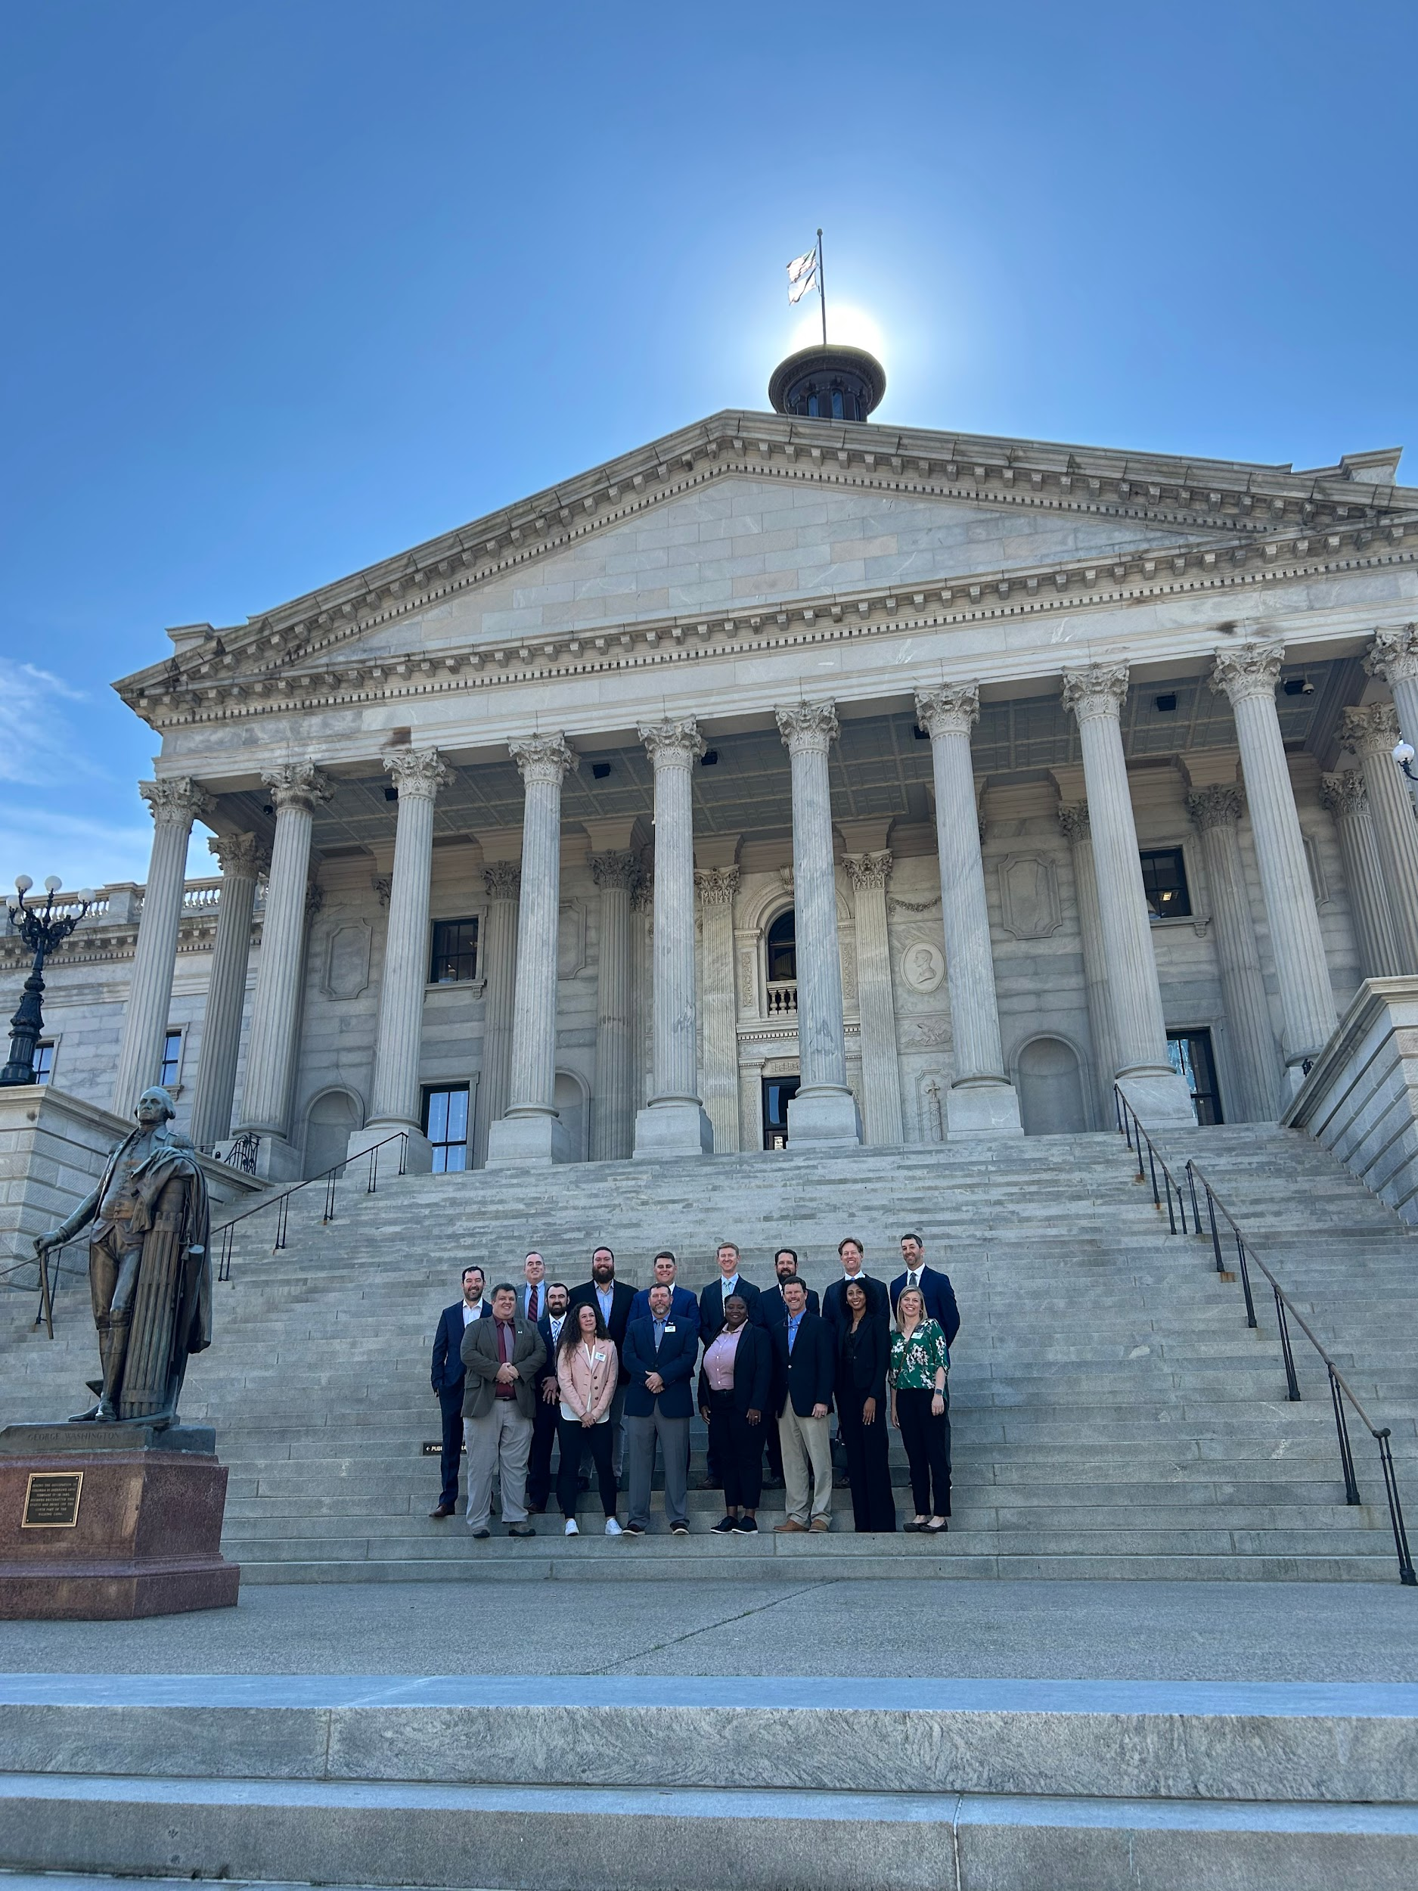
Hit the Hill Day
15 Athletic Trainers
Proclamation in the House for Athletic Trainer Day in SC
Met with Senators and Representatives

Slide 67
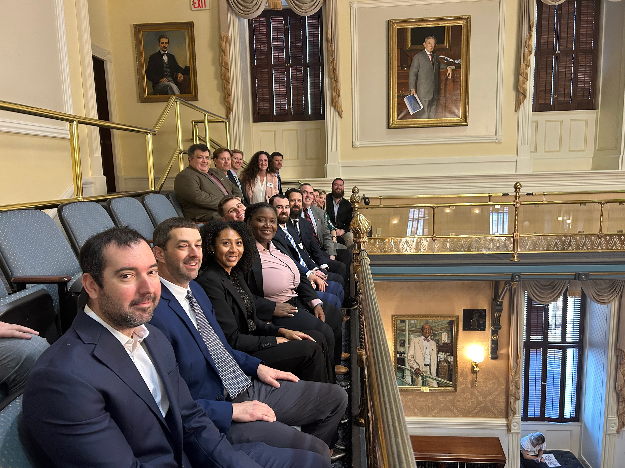
2025 Legislative Session
Bill Tracking
Supported Smart Heart Act H3831
Worked with BIASC to adjust updates to Concussion bill they put forth
Monitored bill to do away with SCHSL

Slide 68


National News
Bill passes to eliminate Athletic Trainers from the US Army H2F program
  Affected 7 AT in SC
Voter Voice (NATA)
Petition (NATA
Reversal
  efforts of NATA (Deanna)

Slide 69
NATA
Membership Benefits
Professional Growth
Support
Advocacy
Connect

Slide 70

Increasing from $30 to $50 in 2026
Less than $2.00 a month
Will allow SCATA to continue to move AT forward in SC
Hasn’t been done in at least 20 years
All money comes to SCATA

Slide 71
Legislative 2026
Looking to fund an AT position through Dept of Ed for every
Adding Athletic Trainers to Code of Laws as Health Care Professional
Monitoring Laws

Slide 72
Unfinished Business and General Orders

Slide 73
NEW BUSINESS
Please utilize the microphones located in the front of the room.

