Slide 1
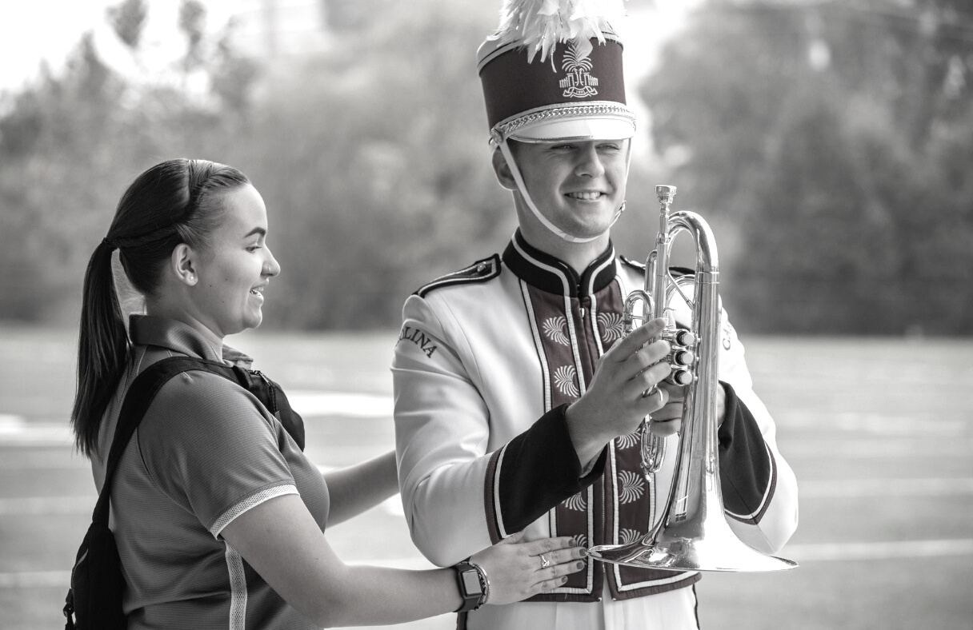

CONSTITUTIONAL UPDATE
South Carolina Athletic Trainers' Association 2022 Annual Symposium

Slide 2


Constitutional Update Process
During the first portion of the Business Meeting we will officially propose the changes and then open a Question and Answer session for membership to ask additional questions about the changes.
Following the opening of the Q&A session we will move on with the normal proceedings of the business meeting.
In the closing session of the Business Meeting all eligible voting members at the business meeting will vote on the proposed changes.
A two thirds majority will be necessary for the proposed changes to be adopted.
South Carolina Athletic Trainers' Association's 2022 Annual Symposium

Slide 3
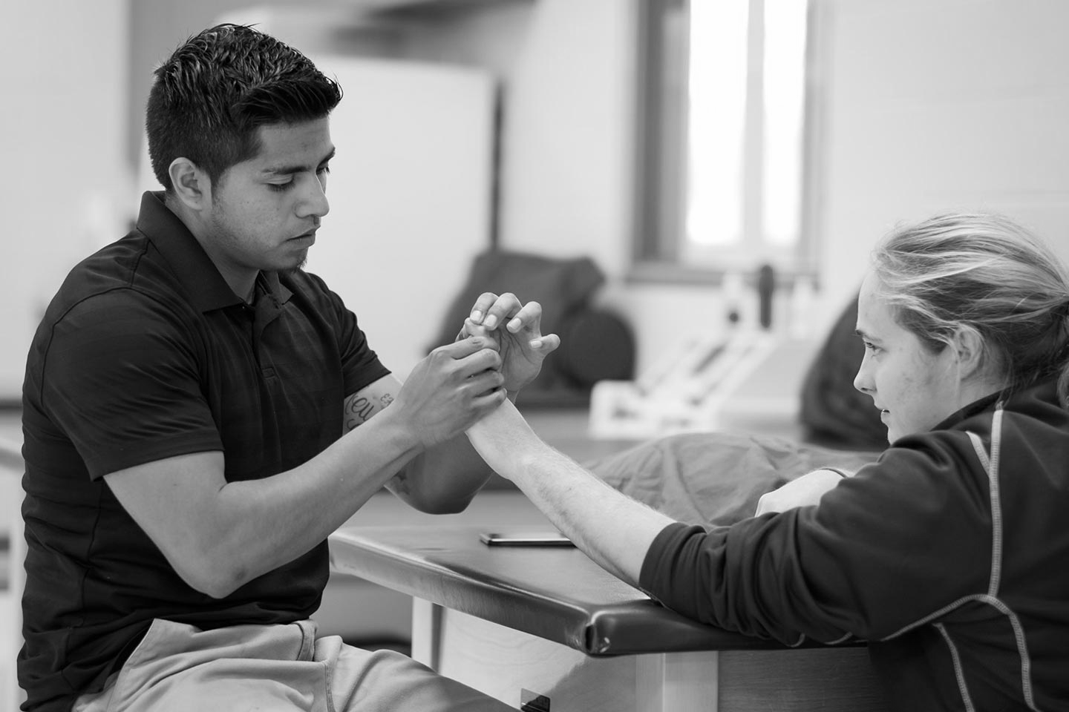
COMMITTEE REPORTS
South Carolina Athletic Trainers' Association 2022 Annual Symposium

Slide 4
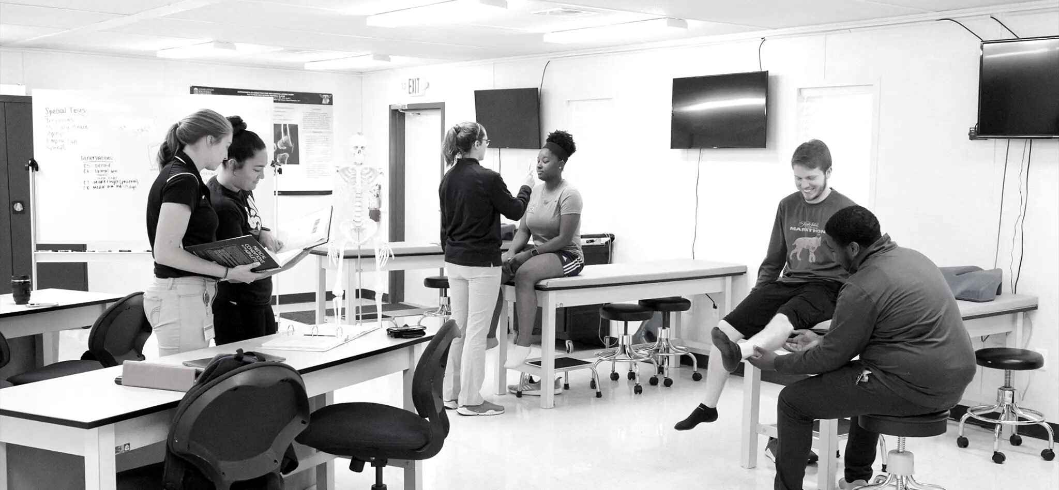
COUNCIL ON PRACTICE ADVANCEMENT
Committee Chair | Tara M. Chase, MS, ATC, SCAT, LMT, CEAS III
Committee Members | Erin Thomas, Mark Mancebo, Jeremy McMicheal, Al Hawkins, Melissa Smith, Dani Jones, Curt Ackerman
Representative | Tara M. Chase, MS, ATC, SCAT, LMT, CEAS III
COMMITTEE UPDATE
Assisted SC Licensure Task Force with Licensure Campaign
Educated & Promoted SC COPA ATCs within our State & District
Worked with Executive Council to include COPA ATCs in nominations
For State & District Leadership Awards
2022-23 COMMITTEE GOALS
Transition committee members and integrate new responsibilities
Continue to update and maintain the SC COPA Directory
Collaborate with Honors & Awards Committee to expand nominee qualifications
Leverage relationship with new District leadership & align long term goals
South Carolina Athletic Trainers' Association 2022 Annual Symposium

Slide 5
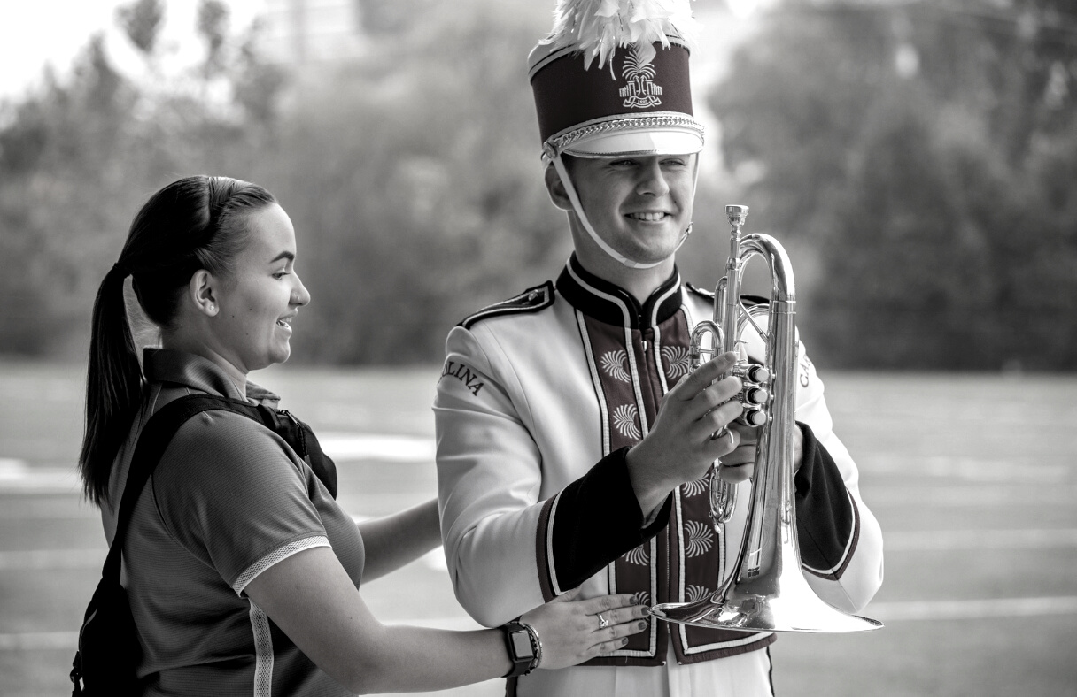
Post Secondary Committee
Committee Chair | Amanda Taylor
Committee Members | Mary Catherine “MC” Avey
Representative
COMMITTEE UPDATE
The Post Secondary Committee is continuing to look for members from the upstate and midlands, please email ataylo8@clemson.edu if you are interested in serving
2022-23 COMMITTEE GOALS
Continue to update and maintain the College and University Directory
Collaborate with the PR Committee to recognize conference and national championship winning athletic trainers
South Carolina Athletic Trainers' Association 2022 Annual Symposium
South Carolina Athletic Trainers' Association 2022 Annual Symposium

Slide 6
PROFESSIONAL EDUCATION COMMITTEE
Committee Chair | Samantha Weber PhD, SCAT, ATC
Committee Members | Martha Rivera, Alanie Rhodes, Vanessa Fulbright, Scott DeCiantis, Emilie Miley
Representative | Samantha Weber PhD, SCAT, ATC
COMMITTEE UPDATE
Student symposium officially combined with professional programming
Savannah Venters to update next
2022-23 COMMITTEE GOALS
Create Student Center on Website for students to access- Working with students
Increase student knowledge of SCATA, MAATA, and NATA with programs across state
Continue to improve student programming
South Carolina Athletic Trainers' Association 2022 Annual Symposium

Slide 7
South Carolina Student Senator Update
Savannah Venters (Savvy)- Limestone University
Student Update
Welcome to all the students here!!
Student Programming available
Quiz Bowl- Thursday 7 Pm!
South Carolina Athletic Trainers' Association 2022 Annual Symposium

Slide 8
ETHNIC DIVERSITY ADVISORY COMMITTEE
Committee Chair | Kenya Moore
Committee Members | Dr. Jim Mensch , Dr. Brian Smith, David Hart
Representative | Jeremy McMichael
COMMITTEE UPDATE
Developing- SCATA survey of SC AT’s who self identify as ethnically diverse- database will serve students and other professionals looking to collaborate, for mentorship/networking, etc.
#2 Grant Proposal (Aims: Retention/Recruitment); HBCU/Small College Connect
#3 Several graduating student EDAC reps
2022-23 COMMITTEE GOALS
#1 Finalize AT database/list
#2 Make significant progress on grant proposal
#3 Member recruitment; committee mentorship efforts with the recruiting of new student EDAC reps for the year
South Carolina Athletic Trainers' Association 2022 Annual Symposium

Slide 9
EXHIBITORS COMMITTEE
Committee Chair | Danny Poole
Committee Members | Rachel Sharpe
Representative
COMMITTEE UPDATE
As of 7/14 we have 19 Exhibitors
Of those 19; we have 2 Platinum, 4 Gold, 1 Silver, and 10 Bronze members
That will bring in $9,450
2022-23 COMMITTEE GOALS
The goal is to always make our exhibitors feel welcomed and appreciated by visiting and talking with them.
We want them to have the best experience of an meeting/conference that they visit.
South Carolina Athletic Trainers' Association 2022 Annual Symposium

Slide 10
GOVERNMENTAL AFFAIRS COMMITTEE
Committee Chair | Mike Rice, MS, ATC, SCAT, NREMT, CKTP
Committee Members | Jen Guiry, David Heim, Scott DeCiantis, Courtney Bowers
Representative
COMMITTEE UPDATE
Licensure Bill (H4179) did NOT pass this year.
2022-23 COMMITTEE GOALS
Hopefully to be able to conduct a Hit the Hill day 2023
Will continue to push for Licensure in the next Legislative Session.
South Carolina Athletic Trainers' Association 2022 Annual Symposium
South Carolina Athletic Trainers' Association 2022 Annual Symposium

Slide 11
HISTORY COMMITTEE
Committee Chair | Walt Gainey
Committee Members | Kim Bressler, Mark Buchman, Craig Clark, Kevin Ennis, Scott Little, Jimmie Rogers, Mike Smith
Representative | Walt Gainey
COMMITTEE UPDATE
#1 Successfully added additional members to committee
#2 Successfully continued to document Athletic Training in SC
#3 Successfully completed first edition and updates of history book
2022-23 COMMITTEE GOALS
#1 Continue to document Athletic Training in SC
#2 Staff History Booth at Symposium (Equipment/Supplies Display, Videos, Info Intake, Brief History PowerPoint Presentation)
#3 Update history book as needed
South Carolina Athletic Trainers' Association 2022 Annual Symposium

Slide 12
HONORS & AWARDS COMMITTEE
Committee Chair | George Wham* *indicates rolling off/or left state
Committee Members | Jim Berry*, Clint Haggard, Emilie Miley*
Representative | George Wham
COMMITTEE UPDATE
Bill Warren - new Hoover Award Winner
Nominations for NATA Awards accepted August 1-September 15
Nominations for MAATA Awards accepted August 15-October 31
SCATA awards nominations close April 15
2022-23 COMMITTEE GOALS
Transition committee members and integrate new responsibilities
Increase the number of SCATA members nominated: NATA, MAATA, & SCATA Awards
Explore new ways to honor / recognize outstanding contributions of SCATA members
South Carolina Athletic Trainers' Association 2022 Annual Symposium

Slide 13
PROGRAM COMMITTEE
Committee Chair | Kyle Prothro, SCAT, ATC
Committee Members | Michelle Lomanaco, Alice McClain, Molly Alexander, Stefanie Cox
Representative | Kyle Prothro
COMMITTEE UPDATE
Return to in person symposium after two year hiatus
Expanding CEU opportunities through regionally based programming throughout the year
Will begin planning for regional CME and 2023 symposium speakers as soon as possible
Looking for several additional committee members
2022-23 COMMITTEE GOALS
Early identification of topics/speakers for 2023 symposium to meet memberships needs and provide superior programming
Initiate regionally based CEU opportunities
Expand committee and increase membership input into continuing education programming
South Carolina Athletic Trainers' Association 2022 Annual Symposium

Slide 14
PUBLIC RELATIONS COMMITTEE
Committee Chair | Abby DeDecker
Committee Members | Amanda Taylor, Zachary Winkelmann
Representative
COMMITTEE UPDATE
Need to look for replacement of all committee members.
Successful NATM 5k, raised approx $1,200 for SafeSport Award Scholarship.
Completed AT Spotlight, SafeSport School award spotlight to highlight members of our organization.
2022-23 COMMITTEE GOALS
Publish content 10x a month to social media feeds.
Receive content from various committees to publish current events, info related to all areas of SCATA.
Expand committee; looking for talent with graphic creating and social media expertise.
South Carolina Athletic Trainers' Association 2022 Annual Symposium

Slide 15
SECONDARY SCHOOL COMMITTEE
Committee Chair | Shawn Zink
Committee Members | Jason Keesee, Katy Campman, Nora Ann Pace, April Taylor, Ben Merritt, Lauren Frick
Representative
COMMITTEE UPDATE
Social Media Recognition of State Championship ATC’s
Selection of All Star ATC’s/Student Aides (North/South, Shrine Bowl)
Updating of Secondary Schools Directory
2022-23 COMMITTEE GOALS
Looking into Mentoring Program for Young SS ATC’s
Update of Mission/Vision Statements
Working to remove obstacles for Committee Meetings
due to work environments and schedules.
Updating Criteria for Student Aides to work All-Star Games.
South Carolina Athletic Trainers' Association 2022 Annual Symposium

Slide 16
SECONDARY SCHOOL STUDENT WORKSHOP
Committee Chair | Hanna Beckman
Committee Members | Vincent Albano, Andrew Ditch, Vanessa Fulbright, Amy Hand, Caitlin Hart, Alice McLaine, Jeremy McMichael, Jim Mensch, Brian Smith, Sam Weber
Representative | Hanna Beckman
COMMITTEE UPDATE
We have not had an in-person workshop since February 2020
2022 - videos made by several colleges / universities to be shared with
secondary school ATs through the SCATA website as a free workshop
SC Sports Medicine & Orthopedic Center has been a faithful sponsor
for several years- greatly appreciated
2022-23 COMMITTEE GOALS
Have an in-person workshop
Have at least 125 students register & attend
Have 3 sponsors at Level 2 Sponsorship of $300+
South Carolina Athletic Trainers' Association 2022 Annual Symposium
South Carolina Athletic Trainers' Association 2022 Annual Symposium

Slide 17
SPECIAL EVENTS COMMITTEE
Committee Chair | Mike Brown
Committee Members | Jim Mensch, Stephanie Rosehart, Craig Oates, Kelly Turney
Representative | Mike Brown
COMMITTEE UPDATE
Golf Outing
Scavenger Hunt: New event to foster connections amongst SCATA members following pre-convention courses.
Thursday Social “Tailgate”: New twist on event to allow for wider connections and increased inclusion amongst all SCATA members.
2022-23 COMMITTEE GOALS
Increase participation in social events surrounding SCATA convention
Provide differing opportunities for professional development, collaboration, and facilitating further inclusion.
South Carolina Athletic Trainers' Association 2022 Annual Symposium

Slide 18
THIRD PARTY REIMBURSEMENT COMMITTEE
Committee Chair | Zachery Richards
Committee Members | Jason Wimberly, John Lopez, Kyle Prothro, Matthew Lyden
Representative | Zachery Richards
COMMITTEE UPDATE
Met with Orthovise representatives Joe Greene and Chris Young to talk about next steps for TPR in SC.
In our meeting we learned about “how” we could utilize TPR.
2022-23 COMMITTEE GOALS
Help with licensure
Once licensure is in place set up TPR bootcamp
Educate membership on Third Party Reimbursement
South Carolina Athletic Trainers' Association 2022 Annual Symposium

Slide 19
YOUNG PROFESSIONALS' COMMITTEE
Committee Chair | Jared Williams (Outgoing) - Alanie Rhodes (Incoming)
Committee Members | Kinsey Dunst, Abbey Earich, Erin Horton (Student), Avery Manbeck (Student) Krista Richards, Savannah Venters (Student), Michaiah Wilson (Student)
Representative | Joe Cauble
COMMITTEE UPDATE
SCATA Book Club - Book 2
SCATA Mentorship Project
Student Symposium
EPC and CAC Influence
Committee Chair Update
Committee Members Update
2022-23 COMMITTEE GOALS
TBD
South Carolina Athletic Trainers' Association 2022 Annual Symposium

Slide 20
HONORS AND AWARDS
South Carolina Athletic Trainers' Association 2022 Annual Symposium

Slide 21
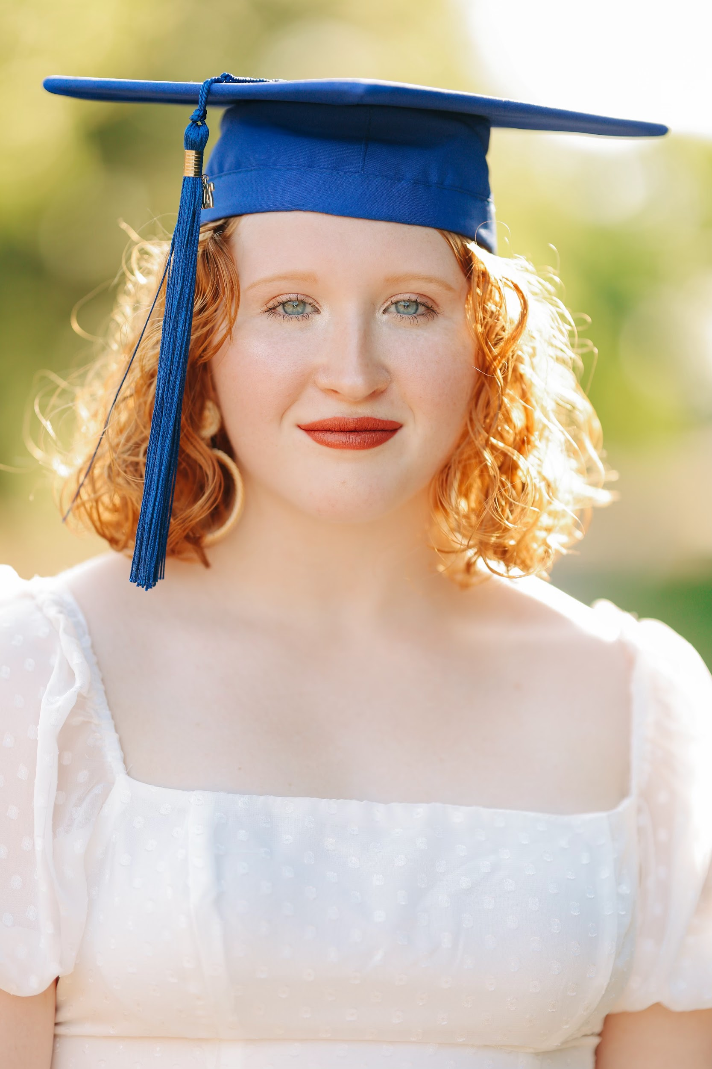
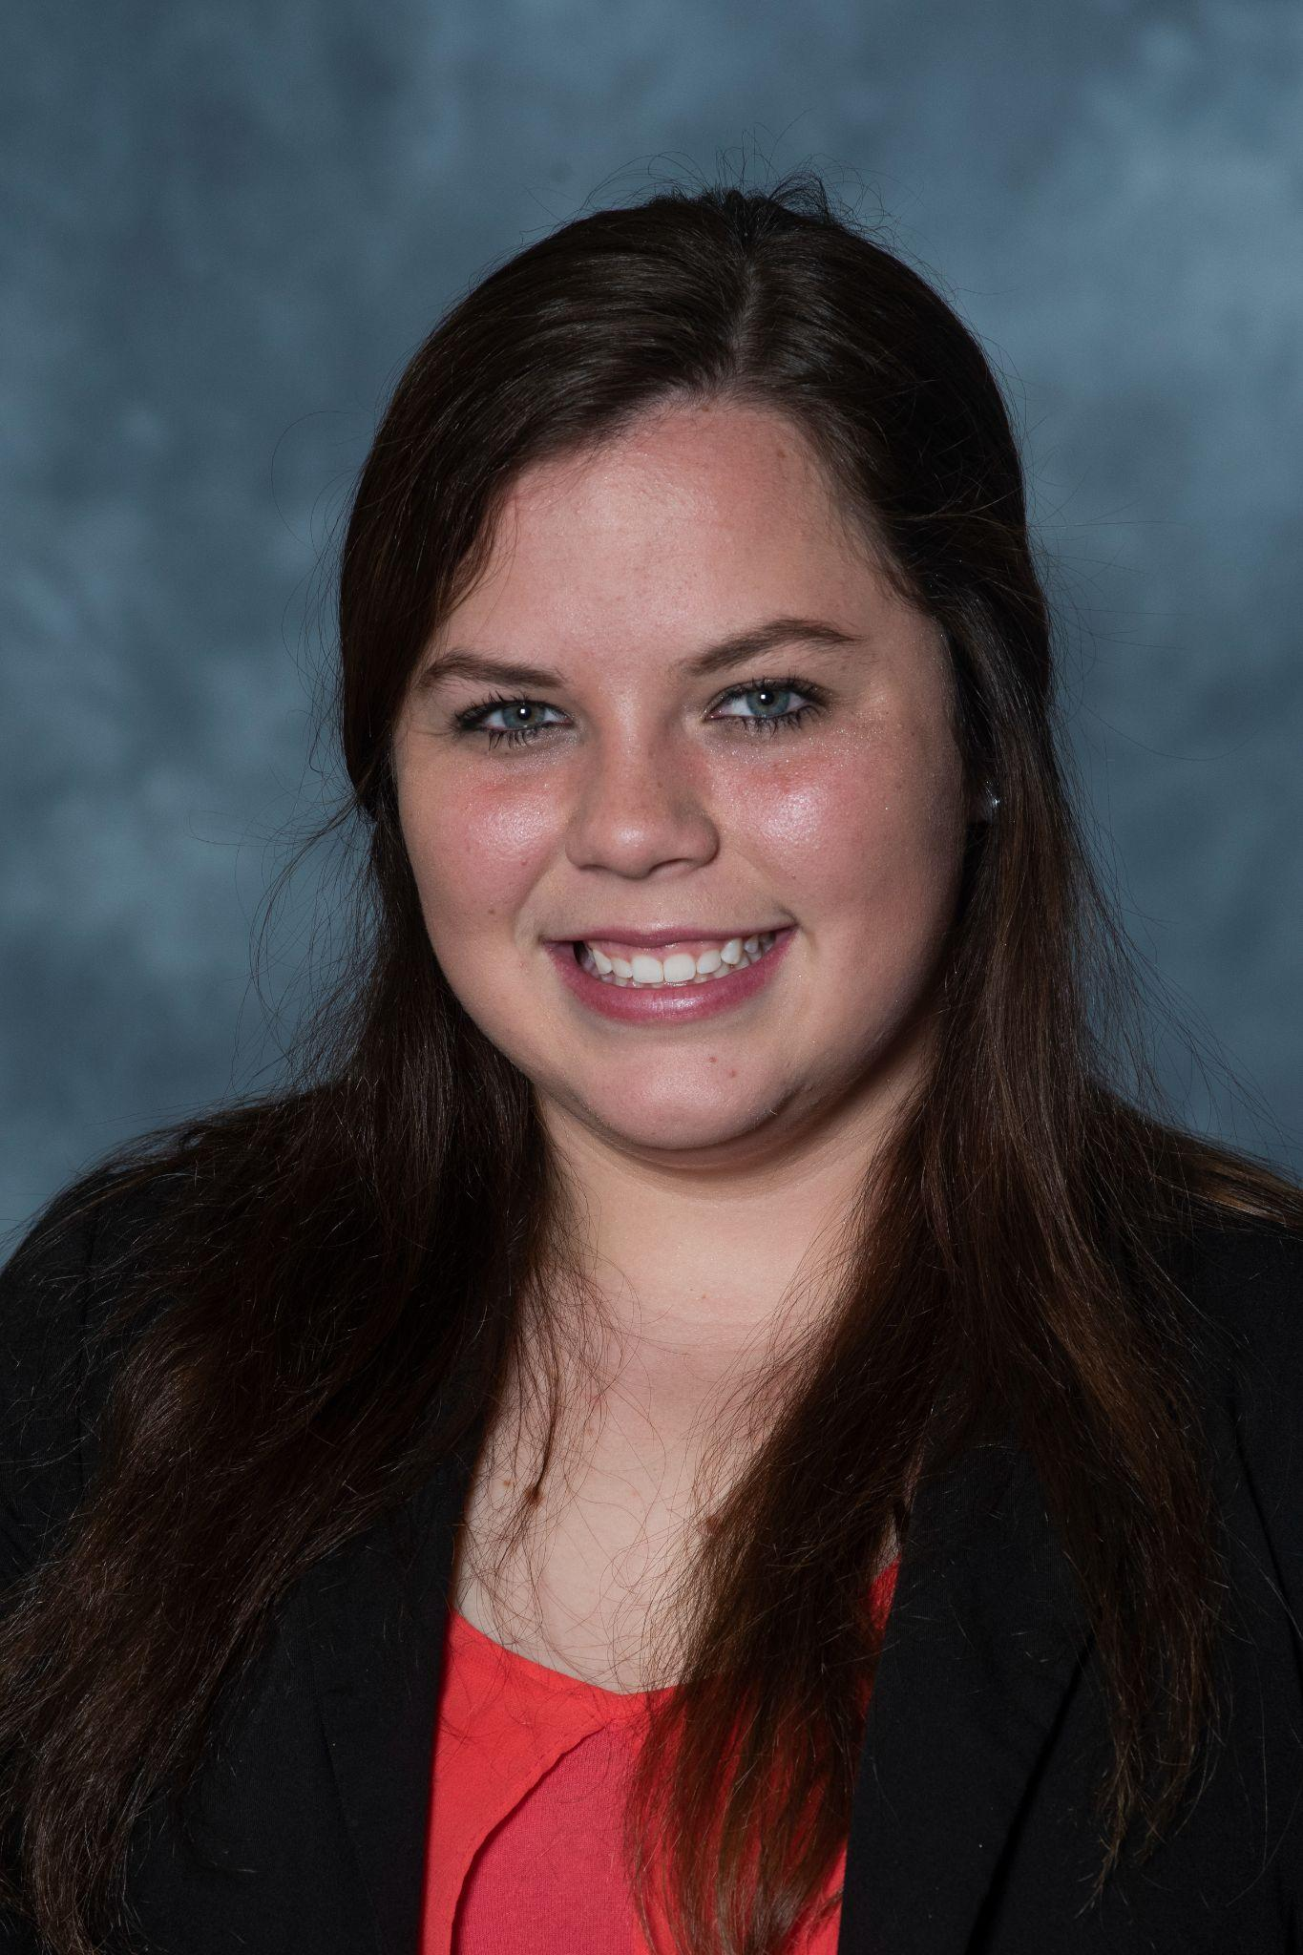
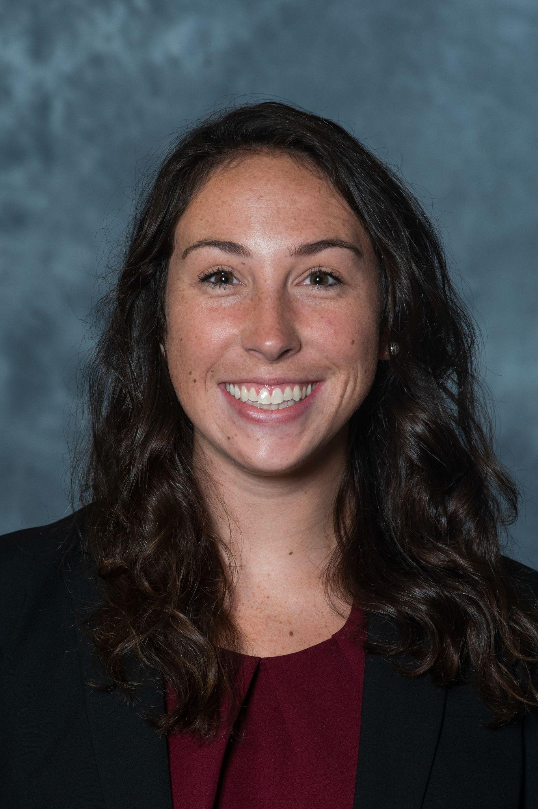
Scholarship Awards
Hannah Sobeski Scholarship
Hayden Pare
Riverside High School
Terry Lewis Memorial Professional
Christina Welmaker
University of South Carolina
Terry Lewis Memorial Post-Professional
Megan Willison
University of South Carolina
South Carolina Athletic Trainers' Association 2022 Annual Symposium

Slide 22
FREE COMMUNICATIONS AWARDS
OUTSTANDING POSTER PRESENTATION: Student Member
Toni Lee
University of South Carolina
The Impact of Type I Diabetes Mellitus in Females on Fracture, Glycemic Control and Bone Mineral Density: A Critically Appraised Topic
OUTSTANDING POSTER PRESENTATION: Certified Member
Katie Rovtar, ATC
Clemson University
Acute Forearm Compartment Syndrome in a Collegiate Softball Player
Please visit the Free Communication and vote for your People’s Choice Award Winner

Slide 23

Palmetto AT Leadership Awards
To recognize excellence in leadership involving people, events, programs, and/or projects that advance the profession of Athletic Training.
One award may be given annually to each representative area. All essential criteria must be met in order to be eligible for an award.
Essential Criteria:
Be an excellent role model
Inspire others to work collaboratively and creatively
Promote an environment that is respectful, collegial and supportive
South Carolina Athletic Trainers' Association 2022 Annual Symposium

Slide 24
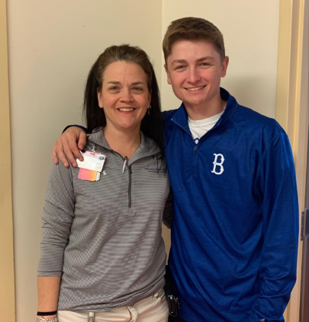
Lifesaving Award
TJ Marsh
Prisma
Grayson Selepes
March 8, 2020
South Carolina Athletic Trainers' Association 2022 Annual Symposium
Notes:
On March 8 at 3:31 p.m., TJ Marsh experienced her worst nightmare as an athletic trainer.
It was the sixth inning of the final game of a preseason doubleheader between Byrnes and Bishop England at Gilbert High School, when a fly ball was hit between shortstop and centerfield.
Grayson Selepes and Easton Cullison collided. Both Byrnes players went down hard, but Selepes wasn’t responsive.
That’s when Marsh rushed into action. After checking Selepes’ vitals, she found no breathing or pulse and immediately started cardiopulmonary resuscitation.
Still no response from Selepes.
For the first time in 23 years as an athletic trainer, Marsh had to utilize an automated external defibrillator (AED). The portable defibrillator shocked Selepes’ heart back into rhythm before the paramedics were able to take him to a hospital.
Both Marsh and the Selepes family agree that without the AED machine on-site, Grayson would not have made it to the hospital.

Slide 25
Palmetto AT Leadership Awards
DEI Leadership
Legislative Leadership
Professional Education Leadership
Professional Education Leadership
Education Leadership
Secondary School Leadership
Post-Secondary School Leadership
Membership Development Leadership
Practice Advancement Leadership
Kenya Moore
Zachary Richards
Michelle Futrell
Stacey Elwood
Zachary Winkleman
Sheila Gordon
Amanda Taylor
Abby DeDecker
Tara Chase
South Carolina Athletic Trainers' Association 2022 Annual Symposium

Slide 26
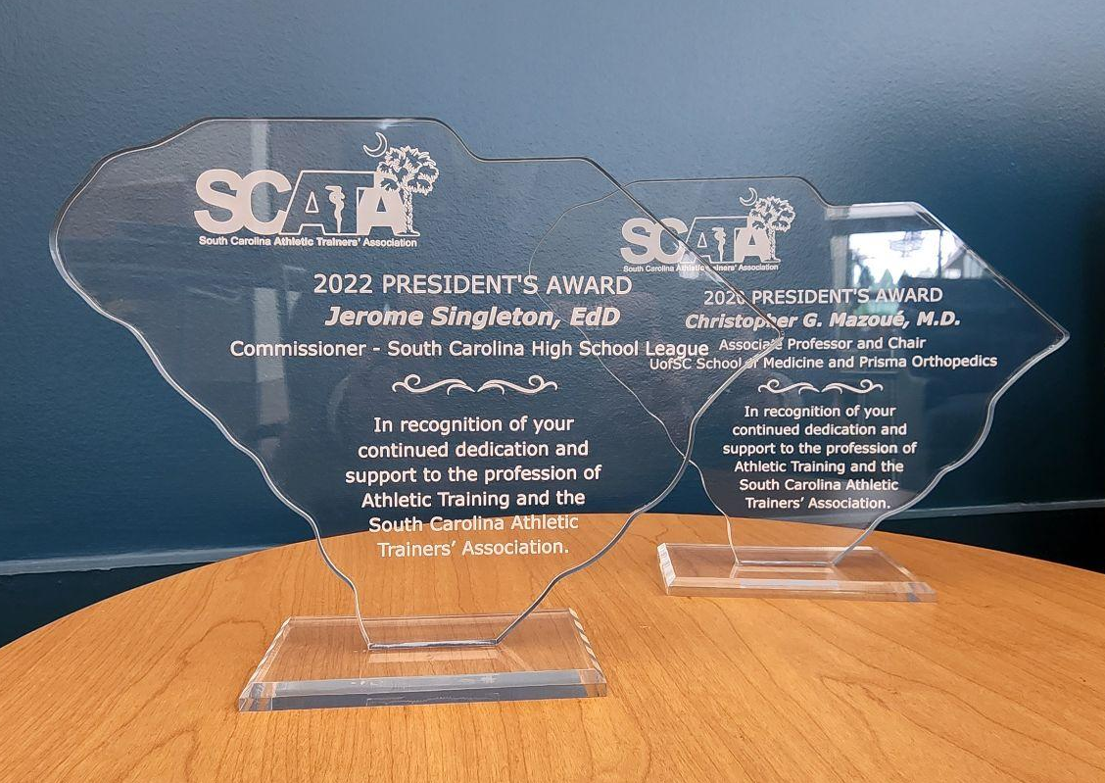
SCATA President’s Award
The President’s Award was established in 2009 to recognize individuals, organizations, corporations, or others who have made outstanding contributions to the membership of the South Carolina Athletic Trainers’ Association.
South Carolina Athletic Trainers' Association 2022 Annual Symposium

Slide 27
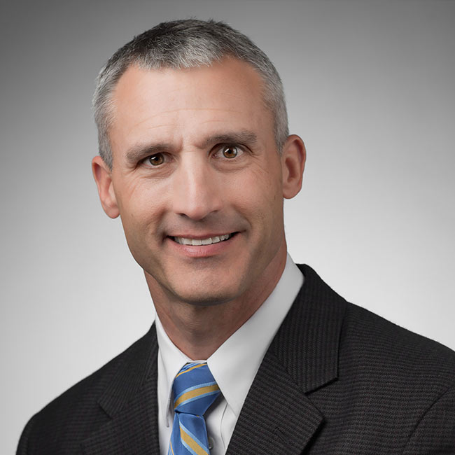
2020 Presidential Award
Christopher George Mazoue, MD
Orthopedic Sports Medicine, Shoulder Orthopedic Surgery
South Carolina Athletic Trainers' Association 2022 Annual Symposium

Slide 28
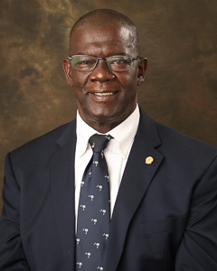
2022 Presidential Award
Jerome Singleton, EdD
Commissioner South Carolina High School League
South Carolina Athletic Trainers' Association 2022 Annual Symposium
Notes:
Dr. Jerome Singleton
a native of South Carolina’s coastal area- having been reared on the banks of SC
in none other than Hollywood (just outside Charleston).
He is a proud Bobcat from Baptist Hill High…As well as an accomplished
graduate from Newberry College (Bachelor of Arts) and Clemson University
(Masters in Education). Commissioner Singleton’s areas of certification include:
Physical Education, Driver’s Education, Secondary Principalship and
Superintendency.
As a product of SC public schools, he combined his love for his home state and
academics by becoming a SC career educator. Commissioner Singleton has
served as an Educator, Coach, and Administrator in the public school systems of
South Carolina his entire career before accepting a leadership position with the
South Carolina High School League.
After fourteen exciting years on the front lines of academia, he accepted a
position as a SCHSL Assistant Executive Director. Within three years, he was
promoted to Associate Director. In 2005, he was named the Commissioner of
the SC High School League. He, along with an enthusiastic staff, is responsible
for governance of athletics in 217 high schools and 205 middle schools.
Nationally, his presence is felt as he has served on several National Federation
of High Schools (NFHS) committees that promote interscholastic athletics.
• Coaches Education
• Cross Country and Track &amp; Field Rules
• Citizenship
• Equity
• National Federation of High Schools Strategic Plan
He has served as the President of the National Federation of High Schools Board
of Directors and as the NFHS Hall of Fame Committee Chairman.
Jerome is married to the former Jacqueline Gibson of Hartsville, SC. They have
three children: two sons, a daughter, and 2 lovely granddaughters and a
newborn grandson.
His latest feat, earning a Doctorate of Education in Educational Leadership, has
put the crown on his list of achievements.
You will find him at local sporting events across the state on any given night or
meeting with state leaders who have a hand in improving the lives of SC student
athletes, both inside and outside the classroom. His life’s passion is to have all
school districts provide an unbiased, safe and invigorating atmosphere in which
children can learn and participate in athletics as they prepare for the challenges
of adulthood.

Slide 29
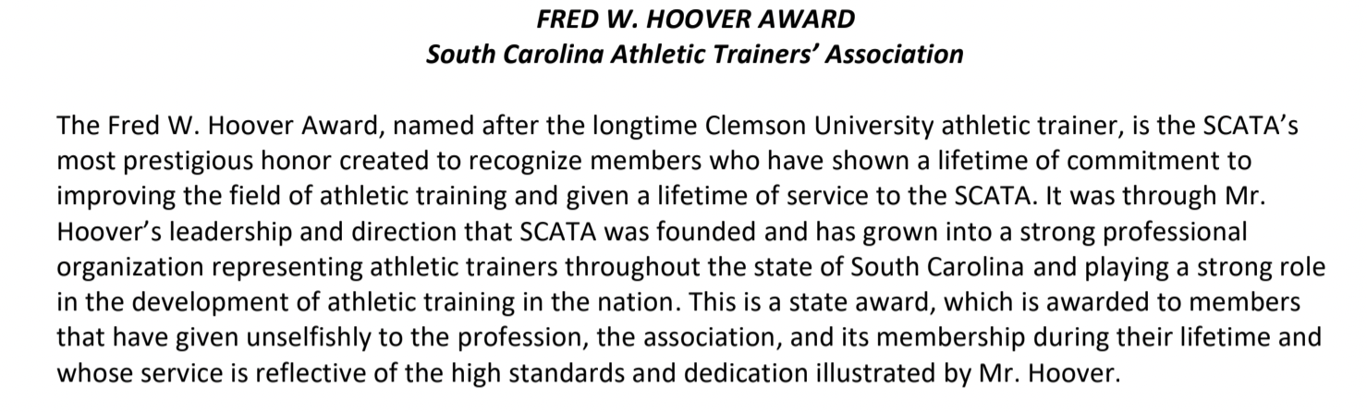
Fred W. Hoover Award for Excellence in Athletic Training

Slide 30
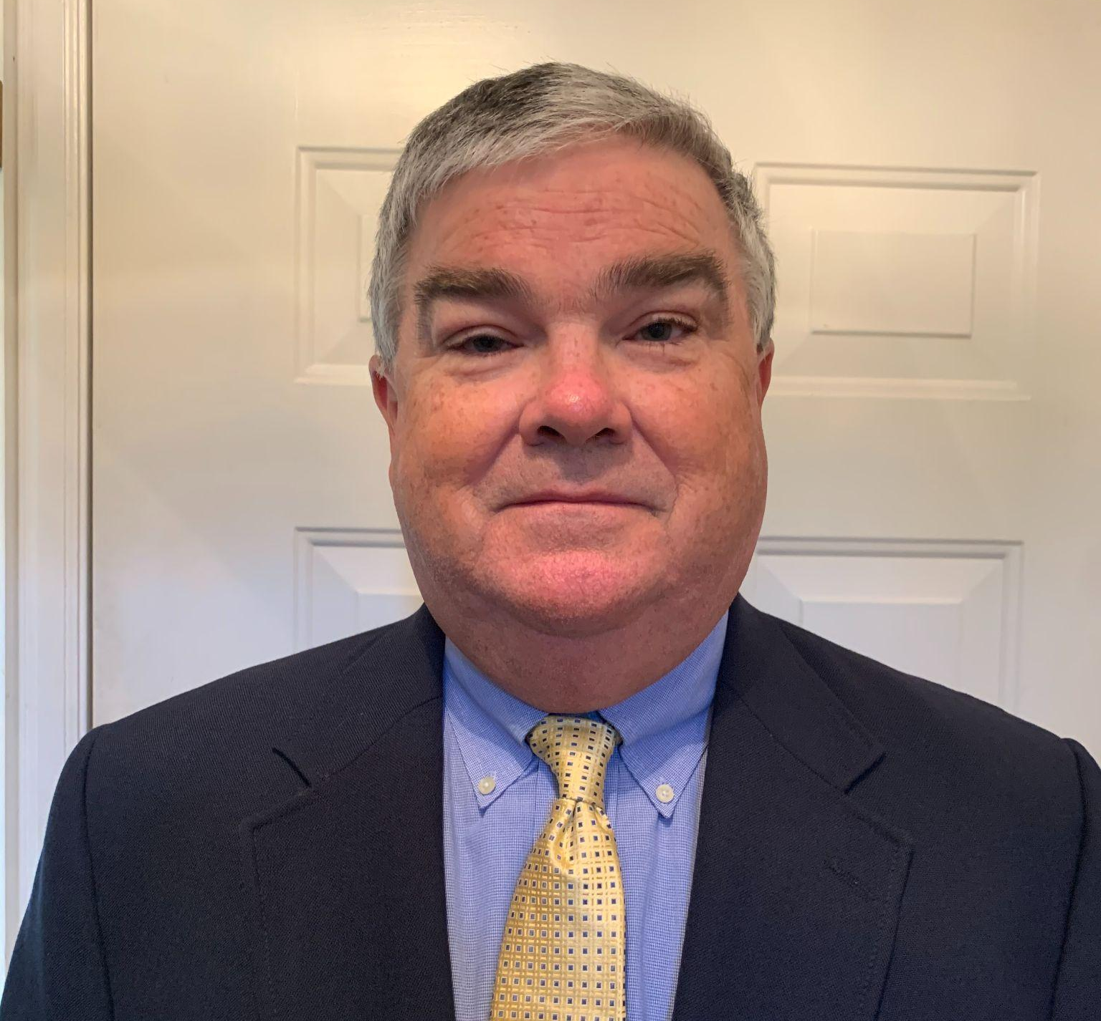
2020 Fred Hoover Award
Notable Contributions
SCATA President, SCATA Executive Council
SCATA HS Student Workshop (Chair), PR, and Golf Tournament Committees
SCATA & MAATA Webmaster
SCATA Rep to SCHSL & SCMA Medical Aspects Committee
NATA State Advisory Committee
MAATA Board of Directors
MAATA Honors & Awards Committee
SCAAA Board of Directors
William “Bill” Warren, MSS, SCAT, ATC
Rock Hill High School
South Carolina Athletic Trainers' Association 2022 Annual Symposium

Slide 31

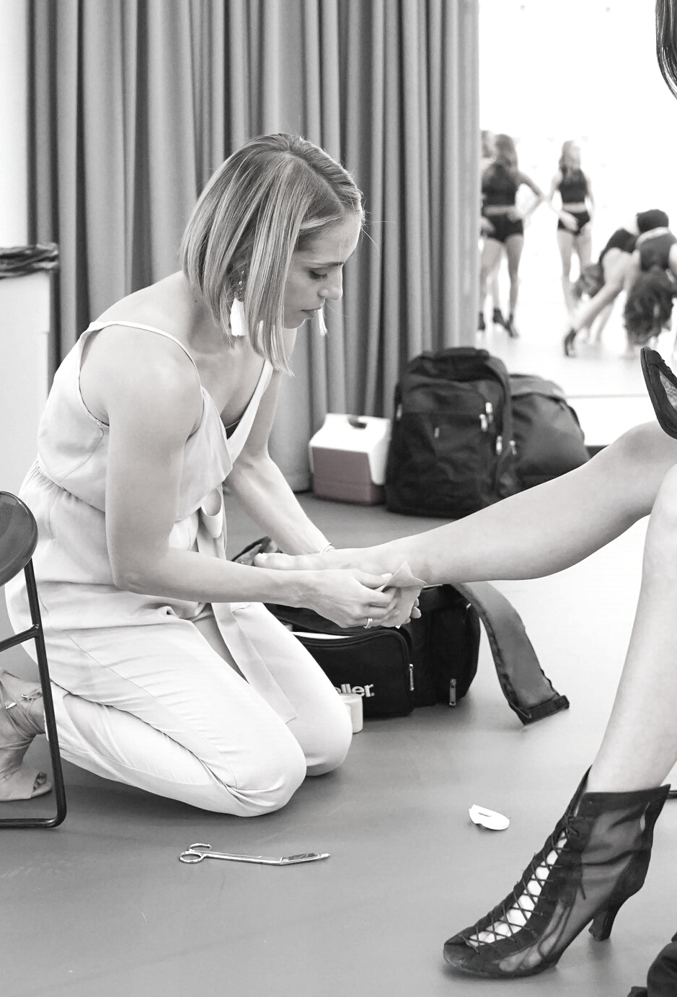
South Carolina Athletic Trainers' Association
2022 ANNUAL SYMPOSIUM
BUSINESS MEETING

Slide 32
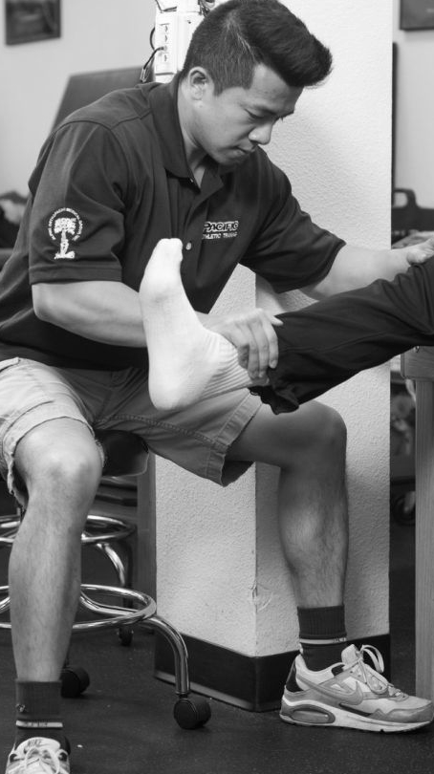
Business Meeting
Welcome
Dispense Minutes from 2021 Business Meeting
Officer Reports
Old Business
New Business
Adjourn
South Carolina Athletic Trainers' Association 2022 Annual Symposium

Slide 33
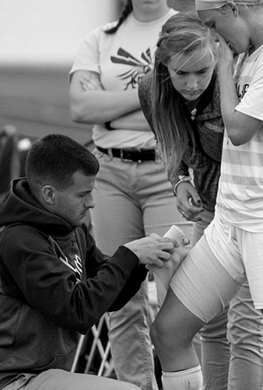
APPROVAL OF MINUTES
SECRETARY
South Carolina Athletic Trainers' Association 2022 Annual Symposium

Slide 34
APPROVAL OF MINUTES
Motion to approve the 2021 Annual Business Meeting minutes. - Andy Clawson
Second of the motion - John Kasik
Discussion
South Carolina Athletic Trainers' Association's 2022 Annual Symposium

Slide 35
REPORTS OF OFFICERS
SECRETARY
TREASURER
PRESIDENT-ELECT
PRESIDENT
South Carolina Athletic Trainers' Association 2022 Annual Symposium

Slide 36
SECRETARY
WILL CHRISTMAN MS, SCAT, ATC
He/Him/His
Spartanburg Regional Hospital System
South Carolina Athletic Trainers' Association 2022 Annual Symposium

Slide 37
SECRETARY REPORT
Membership Dues
$30.00 Annually
NATA members with a South Carolina address will have funds automatically routed to SCATA
  Update your addresses
Non NATA members renew through SCATA
  Renew Jan of each year
  Accounts will be suspended in May if not paid
Retirees
  Send an email to secretary@scata.org
South Carolina Athletic Trainers' Association's 2022 Annual Symposium

Slide 38
SECRETARY REPORT
Membership Numbers
Classification NATA Non-NATA
Certified (SC resident) 683 209
Certified (Non SC res) 38 1
Retired 23 3
Student (SC resident) 22 3
Associate (SC Resident) 10 4
South Carolina Athletic Trainers' Association's 2022 Annual Symposium

Slide 39
TREASURER
JOE CAUBLE, MA, SCAT, ATC
McLeod Health
South Carolina Athletic Trainers' Association 2022 Annual Symposium

Slide 40
ASSETS
Current Assets
Bank Accounts
Checking | $39,259.74
Money Market | $ 138,775.52
Total Bank Accounts | $ 178,035.26
Total Current Assets | $ 178,035.26
TOTAL ASSETS | $ 178,035.26
LIABILITY AND EQUITY
Total Liabilities
Equity
Opening Balance Equity | $ 0.00
Retained Earnings | $ 128,396.95
Net Income | $ 49,638.31
Total Equity | $ 178,035.26
TOTAL LIABILITIES AND EQUITY | $ 178,035.26
Treasurer’s Report
Balance Sheet
As of
07/13/2022
TREASURER REPORT
South Carolina Athletic Trainers' Association's 2022 Annual Symposium

Slide 41
Expenses | FY22 Actual
Annual Symposium | $3,637.45
Committee Expenses | $16,667.22
Insurance | $2,503.00
Miscellaneous | $1,143.27
Office Supplies & Software | $4,858.68
Professional Services | $12,477.00
Travel/CE | $4,885.06
Web Services | $0.00
Total Expenses | $46,171.68
Income | FY22 Actual
Grants | $0.00
Interest | $71.61
Membership Dues | $21,510.71
Miscellaneous | $1,301.82
Scholarship Donations | $1,200.00
Sponsorships | $9,850.00
Symposium/Workshop Registrations | $46,422.50
Total Income | $80,356.64
Net Income | $34,184.96
TREASURER REPORT
South Carolina Athletic Trainers' Association's 2022 Annual Symposium

Slide 42
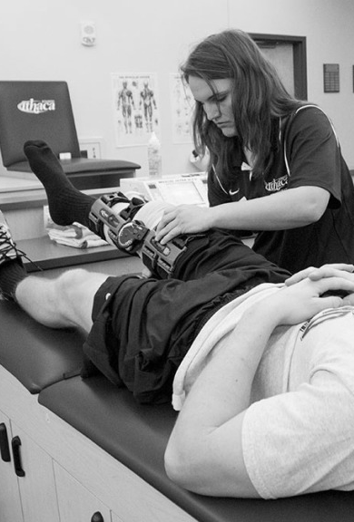
PRESIDENT-ELECT
AMY FRALEY HAND, PhD, SCAT, ATC, CSCS
University of South Carolina
she/her/hers
South Carolina Athletic Trainers' Association 2022 Annual Symposium

Slide 43
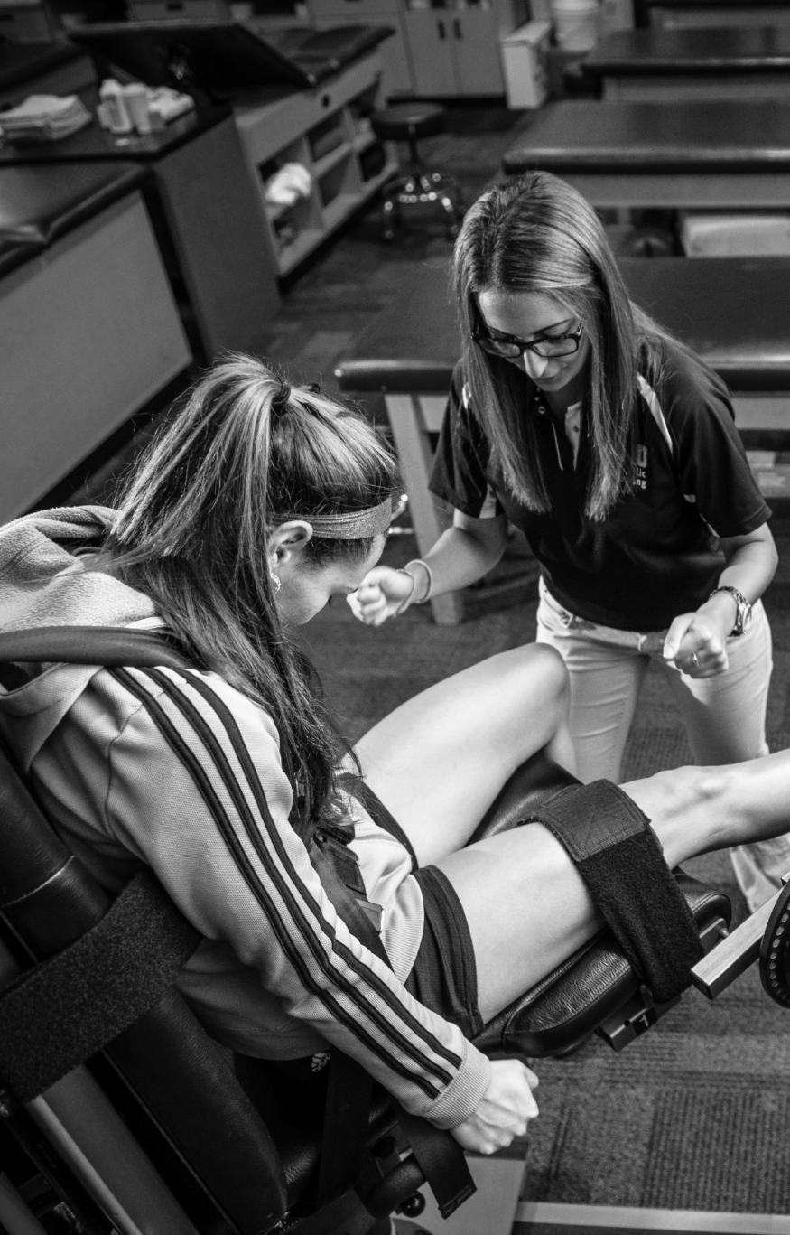
ANNUAL SYMPOSIUM
Thank You!
Total Registrations: 398
Certified SCATA Member: 290
Student SCATA Member: 35
Certified Non-SCATA Member: 58
Complimentary/Speaker/Invited Guest Registration: 26
12.5 Category A, 3 DHEC
Free Communications
One additional Cat A CEU from Gatorade available as asynchronous content
South Carolina Athletic Trainers' Association's 2022 Annual Symposium

Slide 44

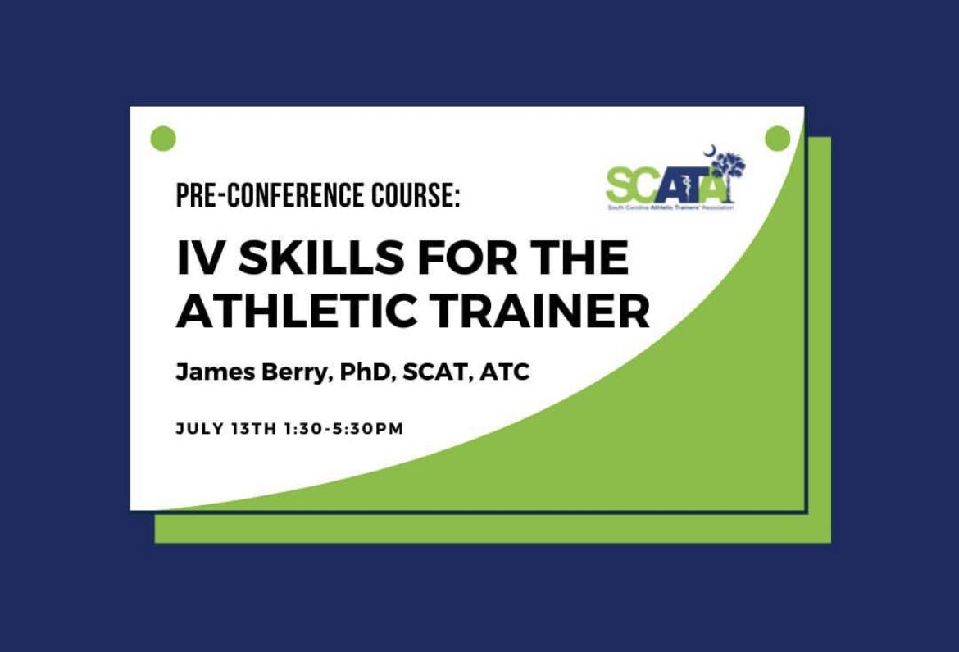
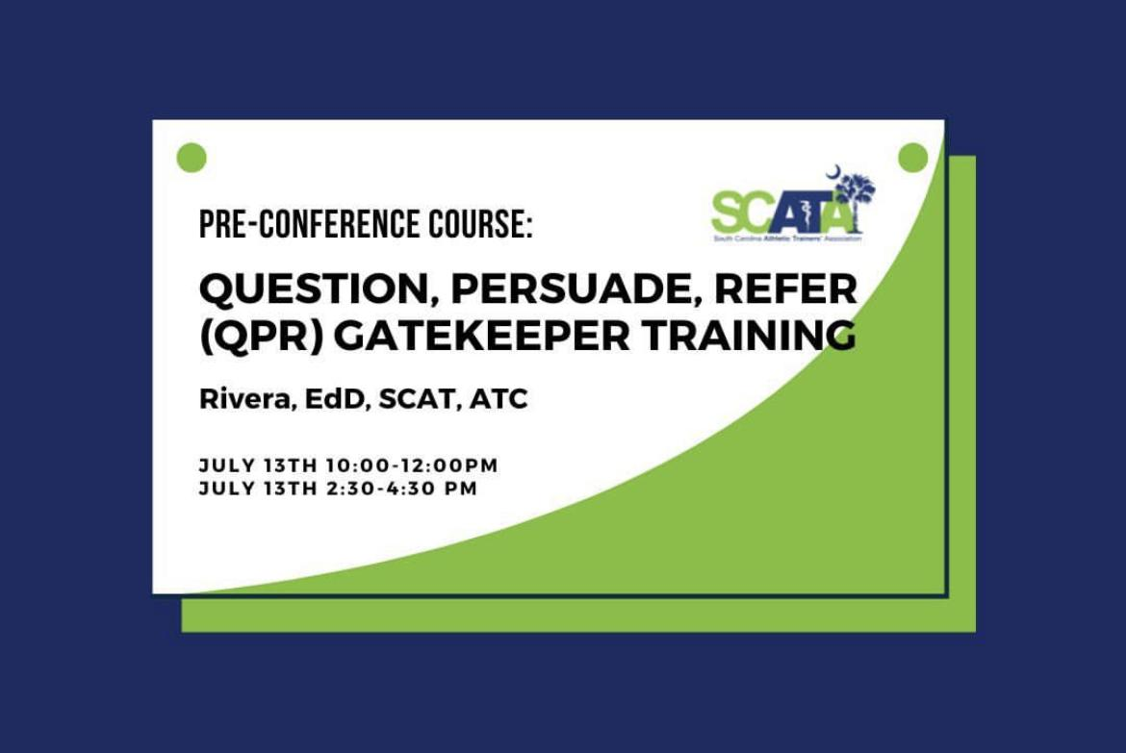

Slide 45

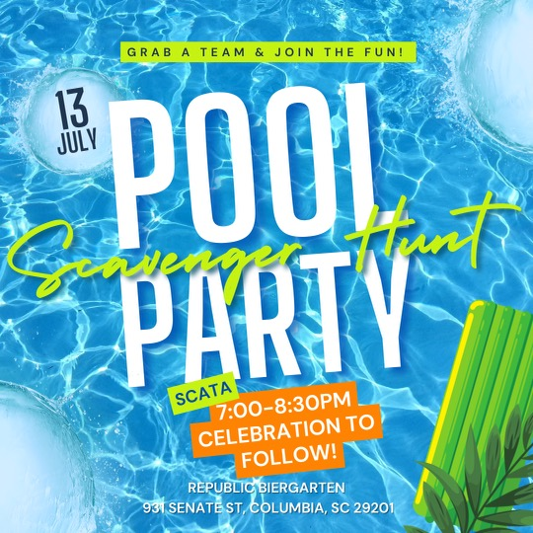

Slide 46
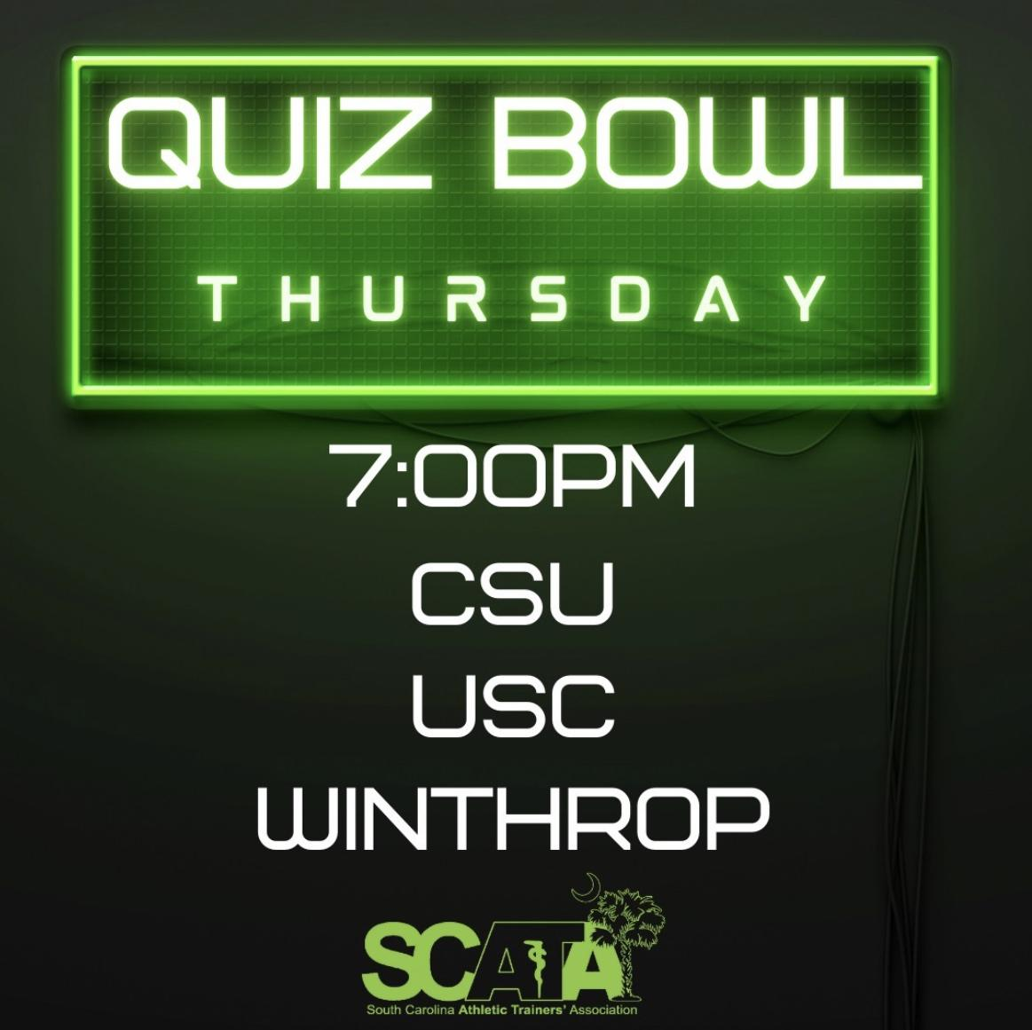


Slide 47


Slide 48
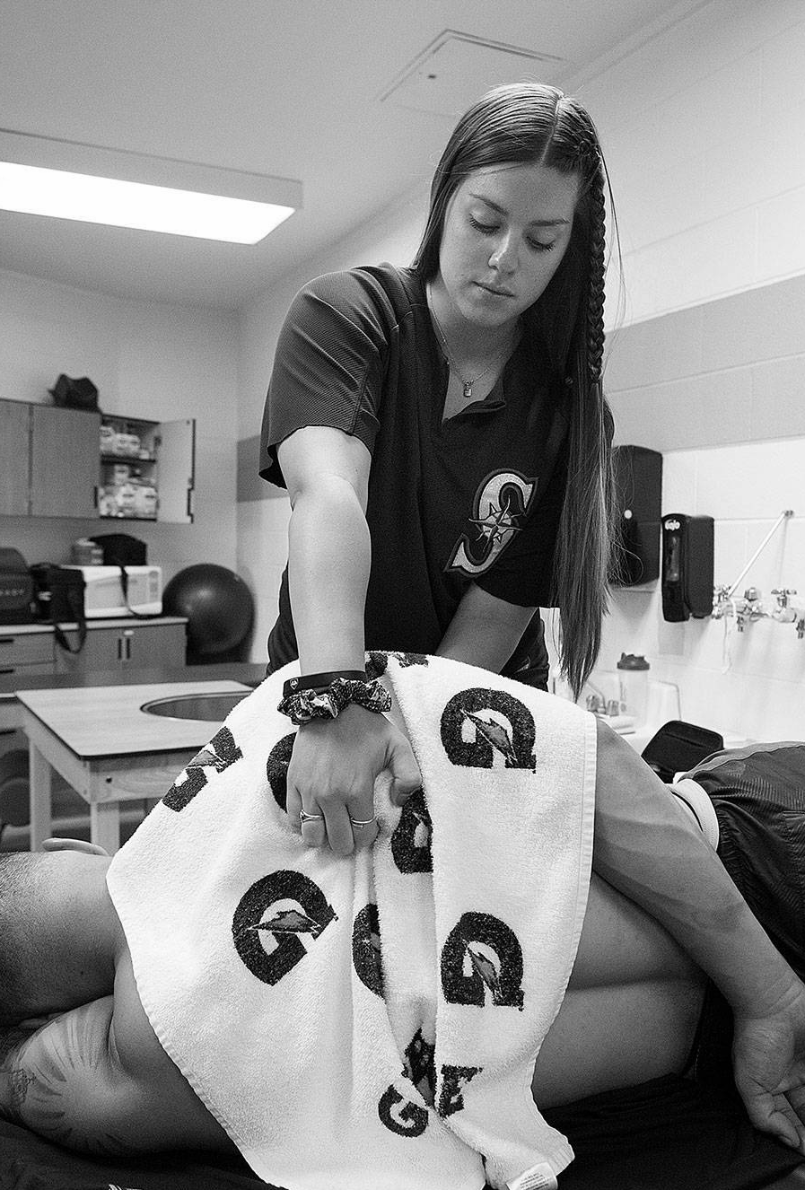
PRESIDENT
JEREMY R. SEARSON, PhD, SCAT, ATC
River Bluff High School
he/him/his
South Carolina Athletic Trainers' Association 2022 Annual Symposium

Slide 49
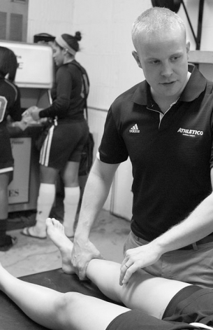
PRESIDENT REPORT
Licensure
Diversity, Equity, Inclusion
Financial Stability
Communication and Transparency
Leadership Opportunities
Future relationship with MAATA/NATA
South Carolina Athletic Trainers' Association's 2022 Annual Symposium

Slide 50
Unfinished Business and General Orders
South Carolina Athletic Trainers' Association 2022 Annual Symposium

Slide 51
NEW BUSINESS
South Carolina Athletic Trainers' Association 2022 Annual Symposium

Slide 52
CONSTITUTIONAL UPDATE
South Carolina Athletic Trainers' Association 2022 Annual Symposium

Slide 53
Constitutional Update
Q&A session
Voting Members of SCATA
A two/thirds majority will be necessary for the proposed changes to be adopted.
South Carolina Athletic Trainers' Association's 2022 Annual Symposium

Slide 54
Constitutional Update
Motion to accept constitutional update as presented.
  Walt Gainey
Second of the motion
  Jerome Razayeski
Discussion
  Discussion will continue until
    No one rises to claim the floor or
    Order of the the assembly
The question is the adoption of the motion that we accept the constitutional updates as presented.
South Carolina Athletic Trainers' Association's 2022 Annual Symposium

Slide 55
Discussion on Constitution update
Question if this is the correct place to put the DEI statement or should it go in By-laws. Some members want to split the updates into sections to vote on.
Motion voted on Yes = 52 and No = 58 so motion does not pass
Motion to Break into Segments - Andy Clawson, 2nd Barry Atkinson
Discussion
People are confused by what the constitution is and what the by-laws are.
Lawyers are split on where the DEI statement should reside in Constitution or by-laws
Motion to table then rescinded by Craig Clark
DEI Statement is needed to support the members of our organization to have inclusion and equal opportunity
Motion is amended by Andy to go back to Committee, 2nd Jerome Razayeski
Yes = 86 and No=44 motion passes to send back to committee

Slide 56
New Business
Please utilize the microphones located in the front of the room.
South Carolina Athletic Trainers' Association's 2022 Annual Symposium

Slide 57
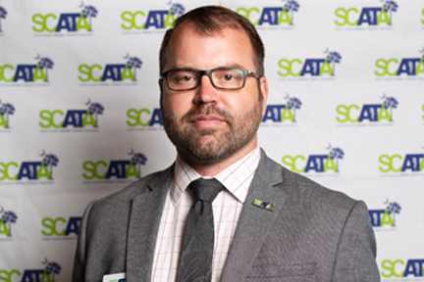
Thank You Jeremy
South Carolina Athletic Trainers' Association 2022 Annual Symposium

Slide 58
Adjourn
Motion to adjourn - Bill Warren
Second of the motion - Craig Clark
The question is the adjournment of the 2022 South Carolina Athletic Trainers’ Association Annual Business Meeting.- Everyone in Favor
South Carolina Athletic Trainers' Association's 2022 Annual Symposium

